Slide 1
Implementing Increased Transparency, and Reproducibility in Economics
Lars Vilhuber
Cornell University
The opinions expressed in this talk are solely the authors, and do not represent the views of the U.S. Census Bureau, the American Economic Association, or any of the funding agencies.
© Lars Vilhuber .
Notes:
I am going to
Very briefly describe the background we are coming from
Make note of the various elements of progress (and the broader picture) of open science
Describe some of the ongoing challenges
Provide a glimpse of what is going to happen in economics, and maybe more broadly in the social sciences.

Slide 2
Efficiency of scholary discourse?
Early publications (20th century) contained tables of data, and the math was simple (maybe)
Data became electronic, was no longer included or cited
Math was transcribed to code, and was no longer included

Slide 3
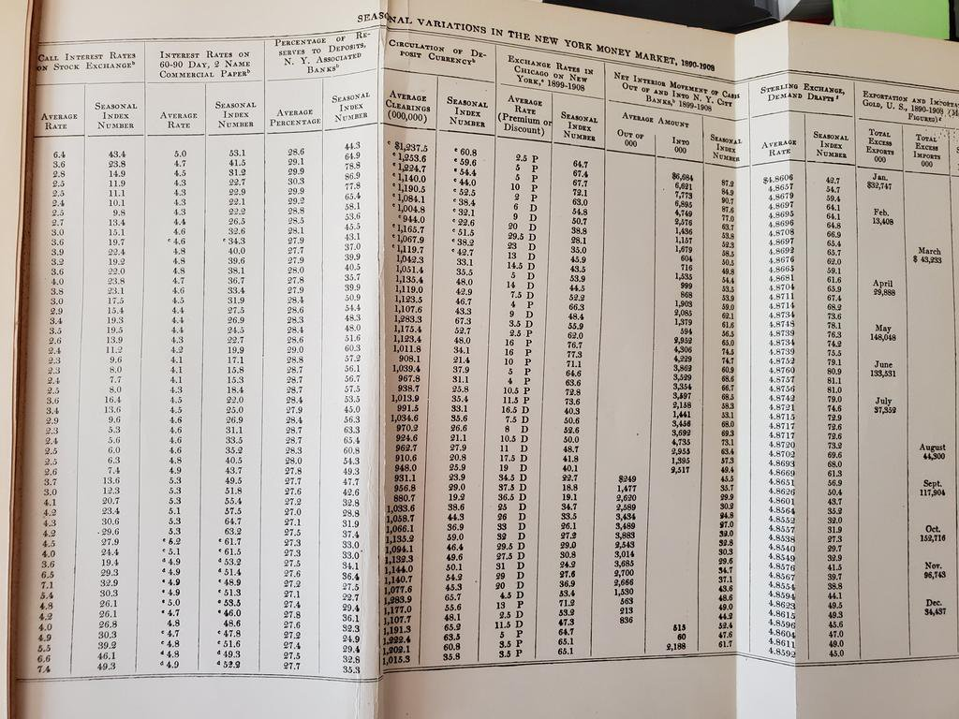
Via @sdellavi
E. W. Kemmerer. 2011. “Seasonal Variations in the New York Money Market.”
The American Economic Review, Vol. 1, No. 1 (March 1911), pp. 33-49

Slide 4
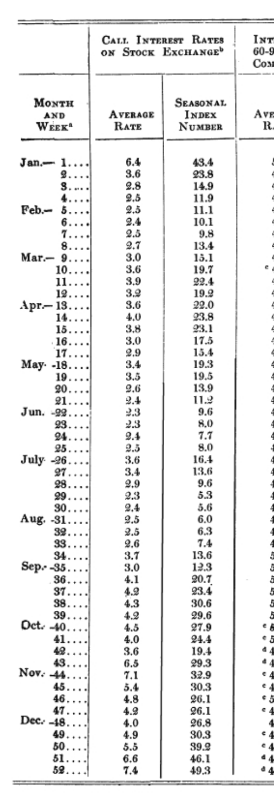
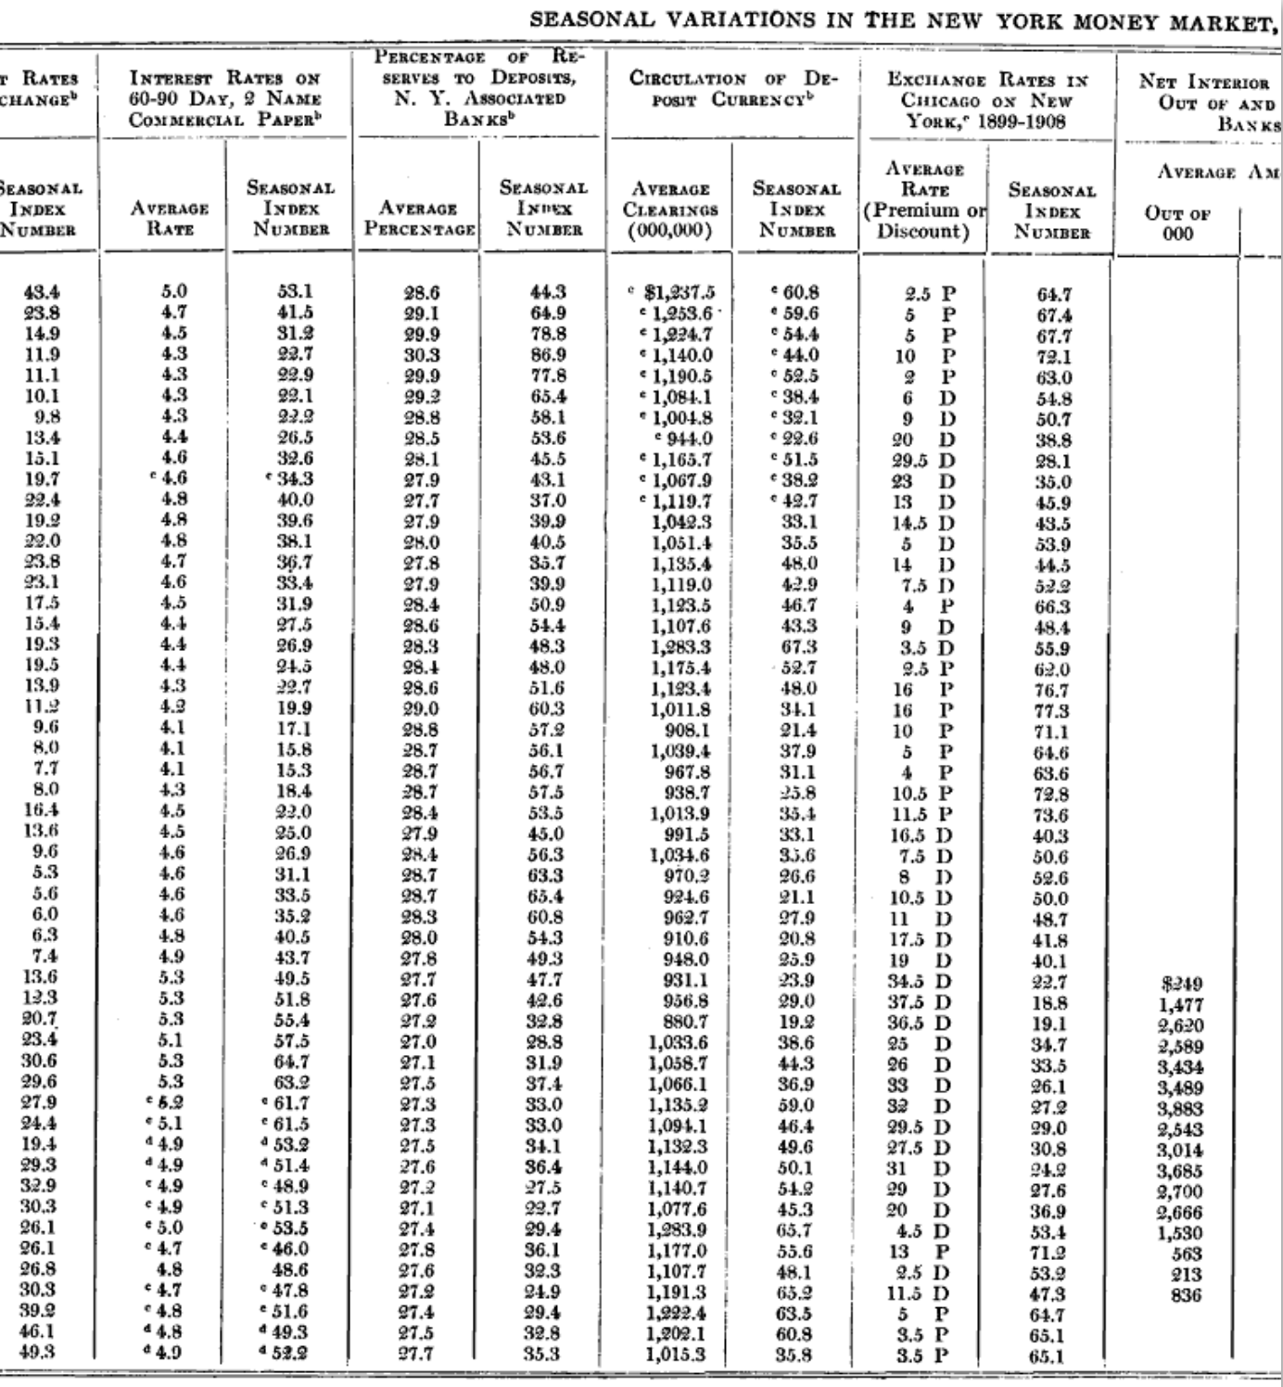
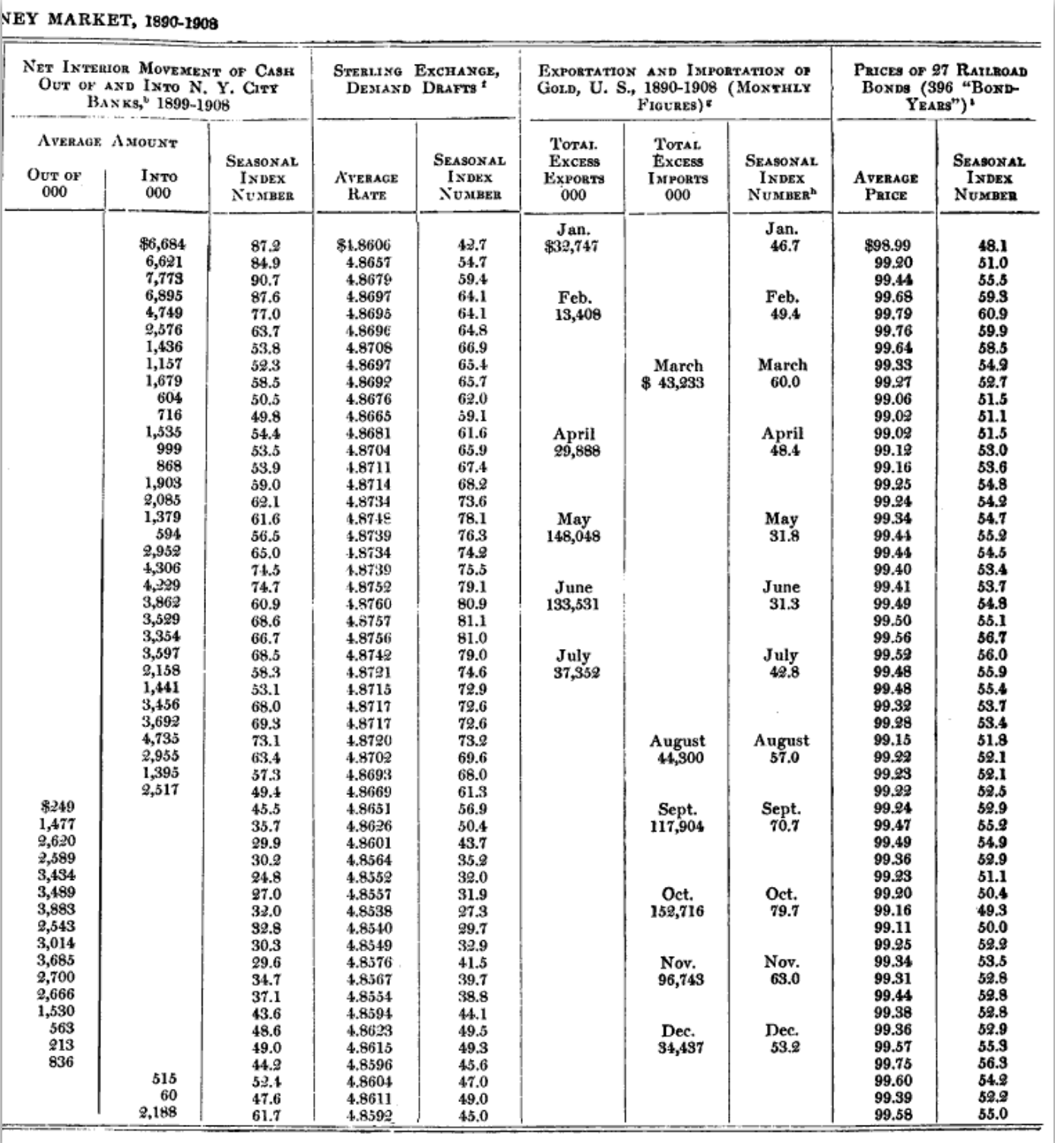

Slide 5
Efficiency of scholary discourse!
Modern publications need the same transparency and completeness as in the old days
to facilitate replicability

Slide 6
Replicability?

Slide 7

Replication continuum
https://doi.org/10.17226/25303
08
Reproducibility
Narrow Replication (Pesaran 2003)
Pure Replication (Hamermesh 2007)
Verification (Clemens 2015)

Slide 8
Replication continuum
Same data | Same code | Same methods | Same context
08
Reproducibility
Narrow Replication (Pesaran 2003)
Pure Replication (Hamermesh 2007)
Verification (Clemens 2015)

Slide 9
Replication continuum
08
08
Reproducibility
Replicability
Narrow Replication (Pesaran 2003)
Pure Replication (Hamermesh 2007)
Verification (Clemens 2015)
Wide Replication (Pesaran 2003)
Statistical Replication (Hamermesh 2007)
Reproduction/Reanalysis (Clemens 2015)

Slide 10
Replication continuum
Same data | Different code | Same methods | Same context
 | or software
08
08
Reproducibility
Replicability
Narrow Replication (Pesaran 2003)
Pure Replication (Hamermesh 2007)
Verification (Clemens 2015)
Wide Replication (Pesaran 2003)
Statistical Replication (Hamermesh 2007)
Reproduction/Reanalysis (Clemens 2015)

Slide 11
Replication continuum
New data | Same code | Same methods | Same context
collection
08
08
Reproducibility
Replicability
Narrow Replication (Pesaran 2003)
Pure Replication (Hamermesh 2007)
Verification (Clemens 2015)
Wide Replication (Pesaran 2003)
Statistical Replication (Hamermesh 2007)
Reproduction/Reanalysis (Clemens 2015)

Slide 12
Replication continuum
08
08
08
Reproducibility
Replicability
Generalizability
Narrow Replication (Pesaran 2003)
Pure Replication (Hamermesh 2007)
Verification (Clemens 2015)
Wide Replication (Pesaran 2003)
Statistical Replication (Hamermesh 2007)
Reproduction/Reanalysis (Clemens 2015)
Wider Replication (Pesaran 2003)
Scientific Replication (Hamermesh 2007)
Reanalysis/Robustness (Clemens 2015)

Slide 13
Replication continuum
Different data | Different code | Different | Different
 | or software | methods | context or
 |  |  | country
08
08
08
Reproducibility
Replicability
Generalizability
Narrow Replication (Pesaran 2003)
Pure Replication (Hamermesh 2007)
Verification (Clemens 2015)
Wide Replication (Pesaran 2003)
Statistical Replication (Hamermesh 2007)
Reproduction/Reanalysis (Clemens 2015)
Wider Replication (Pesaran 2003)
Scientific Replication (Hamermesh 2007)
Reanalysis/Robustness (Clemens 2015)

Slide 14
Progress

Slide 15
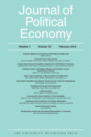
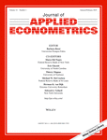


Progress
Replication archives and Data (Code) Availability policies

Slide 16
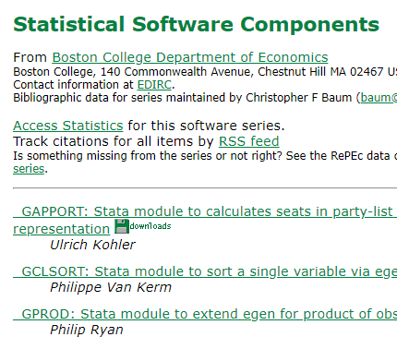

Progress
Replication archives and Data (Code) Availability policies
Shared open source software

Slide 17




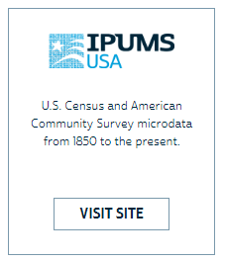


Progress
Replication archives and Data (Code) Availability policies
Shared open source software
Better public-use and shared data

Slide 18


Progress
Replication archives and Data (Code) Availability policies
Shared open source software
Better public-use and shared data
Better ways of accessing preprints/ grey literature

Slide 19
Issues

Slide 20
Replication continuum
Same data | Same code | Same methods | Same context
08
08
08
Reproducibility
Replicability
Generalizability
Narrow Replication (Pesaran 2003)
Pure Replication (Hamermesh 2007)
Verification (Clemens 2015)
Wide Replication (Pesaran 2003)
Statistical Replication (Hamermesh 2007)
Reproduction/Reanalysis (Clemens 2015)
Wider Replication (Pesaran 2003)
Scientific Replication (Hamermesh 2007)
Reanalysis/Robustness (Clemens 2015)

Slide 21
Results?

Slide 22
Some key statistics
Study | Year | N | Success | Type | Type-R | Type-Data | Percent | Field
Dewald Thursby Anderson | 1986 | 54 | 2 | Complete | Reproducibility | Avail | 4% | Economics
Dewald Thursby Anderson | 1986 | 54 | 7 | Partial | Reproducibility | Avail | 13% | Economics
McCullough McGeary Harrison | 2006 | 186 | 14 | Complete | Reproducibility | All | 8% | Economics
McCullough McGeary Harrison | 2006 | 62 | 14 | Complete | Reproducibility | Avail | 23% | Economics
Nosek et al | 2015 | 100 | 36 | Complete | Replication |  | 36% | Psychology
Camerer et al | 2016 | 18 | 11 | Complete | Replication |  | 61% | Experimental Econ
Chang Li | 2017 | 67 | 22 | Complete | Reproducibility | Avail | 33% | Macroeconomics
Kingi et al | 2018 | 274 | 69 | Complete | Reproducibility | All | 25% | Economics
Kingi et al | 2018 | 162 | 69 | Complete | Reproducibility | Avail | 43% | Economics
Kingi et al | 2018 | 162 | 137 | Partial | Reproducibility | Avail | 85% | Economics
Kingi et al numbers are preliminary. Do not cite or quote.

Slide 23
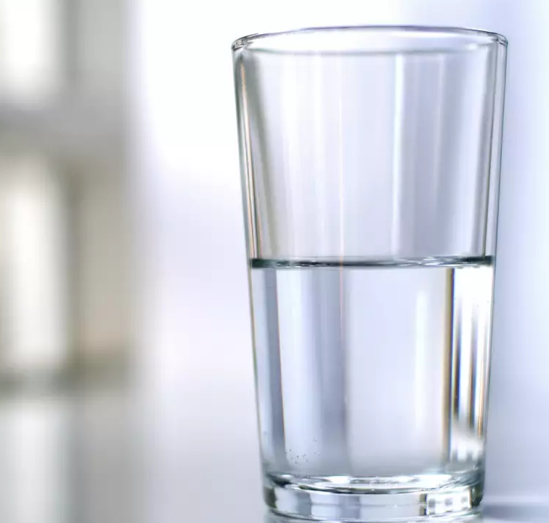
In a nutshell
40% use restricted-access data
25% use public-use data and are mostly or completely reproducible
25% use public-use data and are only partially reproducible
10% fail to yield useful results
It’s only ½ full!
Hey, it’s not empty!

Slide 24
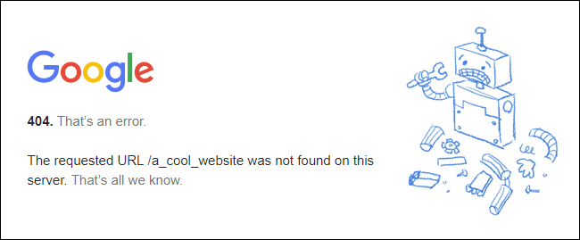
Failure to curate

Slide 25
Poor citation practices
Macrodata:
“We use data downloaded from the Bureau of Economic Analysis…”
Microdata:
“… this paper uses data from the Current Population Survey…”

Slide 26
Problems describing RELIABLE archives
Many datasets
Are imperfectly described
Very few data citations
Are badly documented
Have no (permanent) location defined
Even for data from high-profile organizations!
All of the above

Slide 27
What to do?

Slide 28
Second round (2012-)
Greater enforcement of data (and code) availability
2015, AJ Political Science
2016, Data Editor for ASA Software Section
2016, Statistical review added Science
2017: AEA appoints Data Editor, with mandate to do similar activities (also EJ, Restud)

Slide 29
→ Verifying reproducibility

Slide 30
Current Data Availability Policies are Broken
If the Data is not open-access, no systematic information is collected (“exemption”)

Slide 31
We asked for “deposits”…
If you used files at the National Archives, would we ask you to “deposit” them?

Slide 32
We asked for “deposits”…
If you used files at the National Archives, you should describe where they are!

Slide 33
→Require greater transparency of data/code

Slide 34
→better provenance description

Slide 35
Why do journals like “supplemental ZIP files” and affiliated repositories?
They can ensure longevity/ persistence
They can ensure access
They can ensure availability

Slide 36
What are the characteristics of trusted repositories (data archives)?
They DO ensure longevity/ persistence
They DO ensure access
They DO ensure availability

Slide 37
Evolving Journal and Data Infrastructure
More self-deposit repositories in the social sciences
Dataverse
Figshare
(open)ICPSR
Zenodo
Qualitative Data Repository (QDR)
Others…

Slide 38
In a nutshell
40% use restricted-access data
25% use public-use data and are mostly or completely reproducible
25% use public-use data and are only partially reproducible
10% fail to yield useful results
It’s only ½ full!
Hey, it’s not empty!

Slide 39
Evolving Journal and Data Infrastructure
More self-deposit repositories in the social sciences
Dataverse
Figshare
(open)ICPSR
Zenodo
Qualitative Data Repository (QDR)
Others…

Slide 40
→Use trusted repositories where possible

Slide 41
Problems with that?

Slide 42
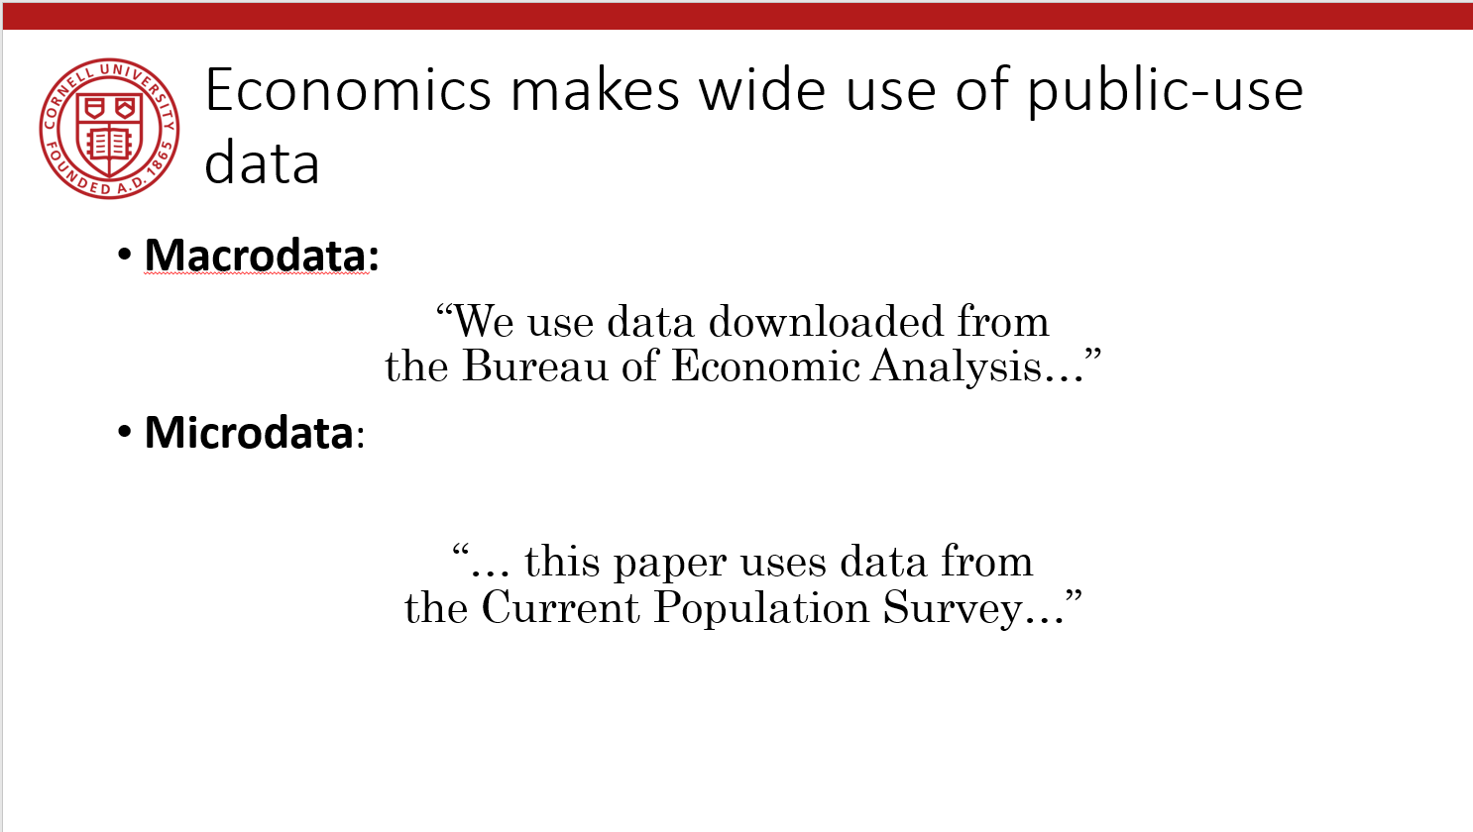
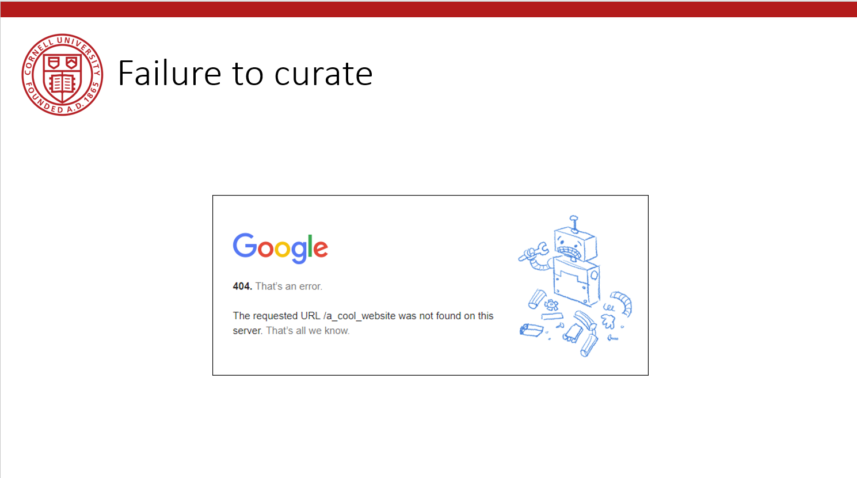
Here are the problems…

Slide 43
Verifying Data and Code Deposits
Not every data repository is created equal
Github, Dropbox, etc. are not data or code repositories
Is the institutional repository at the University of Southern Venezuela a reliable repository?
Is the institutional repository at Cornell University a reliable repository?
Is the institutional repository at Harvard University (Dataverse!) a reliable repository?
Are the National Archives a reliable repository?

Slide 44
Verifying Data and Code Deposits
Not every restricted-access repository is created equal
The Second Bank of Third City credit card data is not a data/code repository
Is the School Board of Third City a reliable repository?
Is the JPMC Institute a reliable repository?
Is the US Census Bureau a reliable repository?
Are any restriced-access repositories reliable archives?

Slide 45
Evolving Journal and Data Infrastructure
So: Describe them!
(cite them!)

Slide 46
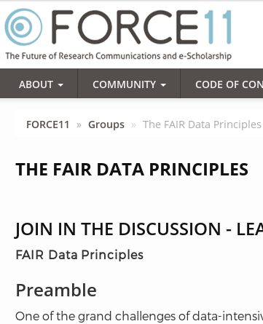
Action: Data citations and metadata
What is FAIR?
Findable,
Accessible,
Interoperable, and
Re-usable

Slide 47
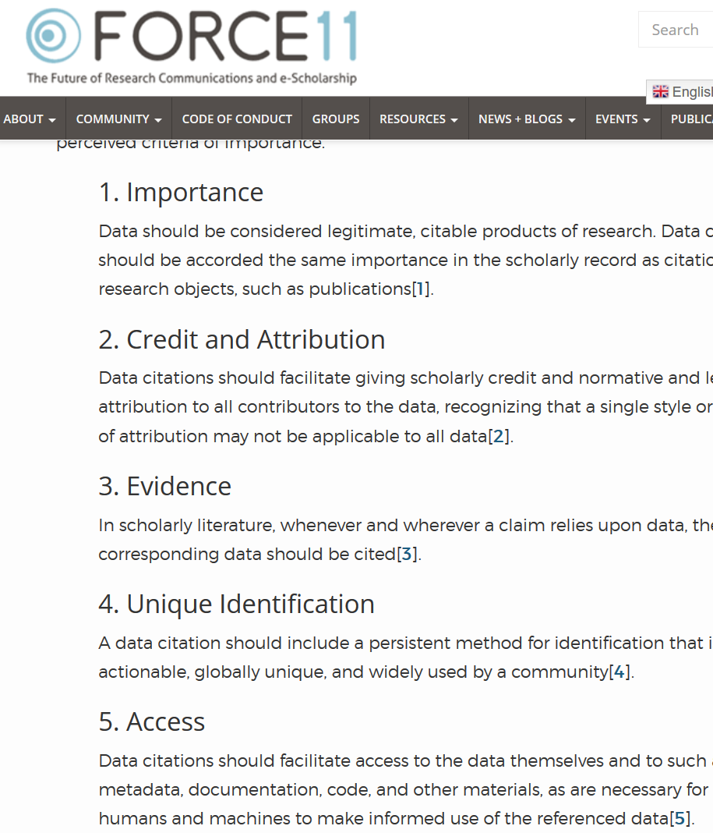

Starts with Data Citations
Data Citation Principles
Image of a standard data citation
Data Citation Synthesis Group: Joint Declaration of Data Citation Principles. Martone M. (ed.) San Diego CA: FORCE11; 2014 [https://www.force11.org/group/joint-declaration-data-citation-principles-final].

Slide 48
Evolving Journal and Data Infrastructure
Data Citations are not enough!

Slide 49
Why are data citations not enough?
They tell you “where”
But most do not
“who can access”
“for how long”
“under what conditions”
(Though in theory, these are covered by the Data Citation Principles)

Slide 50
Data Availability Statements (DAS)
A statement about where data supporting the results reported in a published article can be found
including unique identifiers linking to publicly archived datasets analyzed or generated during the study.
DASs can increase transparency by providing a reason why data cannot be made (immediately) available
need for registration, ethical or legal restrictions, or because of an embargo period

Slide 51
Data Availability Statements
A statement about how long data will be available (policy)
DOI assignments implies long-term curation
But long-term curation does not require DOI!
A statement about usage rights
Not every dataset is in the public domain
Not everybody knows that U.S. Government data are usually in the public domain

Slide 52
→Improve provenance documentation

Slide 53
Why Reproducibility, Provenance?

Slide 54
Credibility

Slide 55
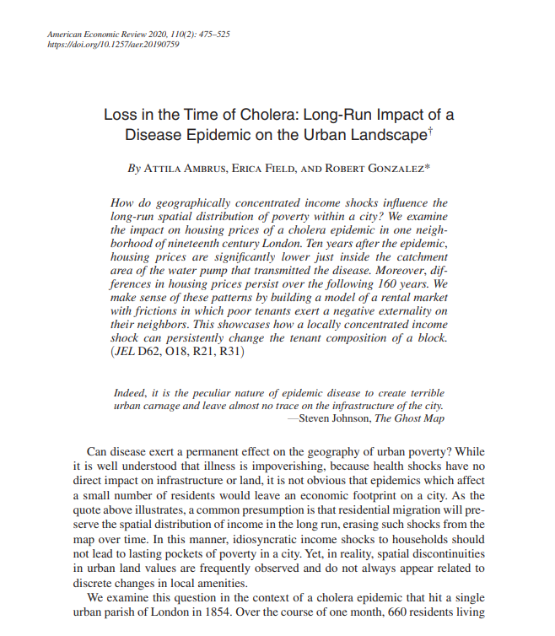
Credibility
https://doi.org/10.1257/aer.20190759

Slide 56
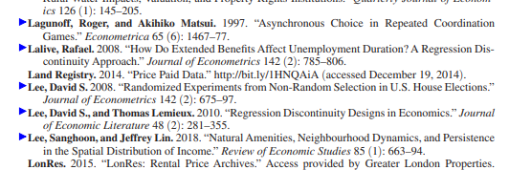
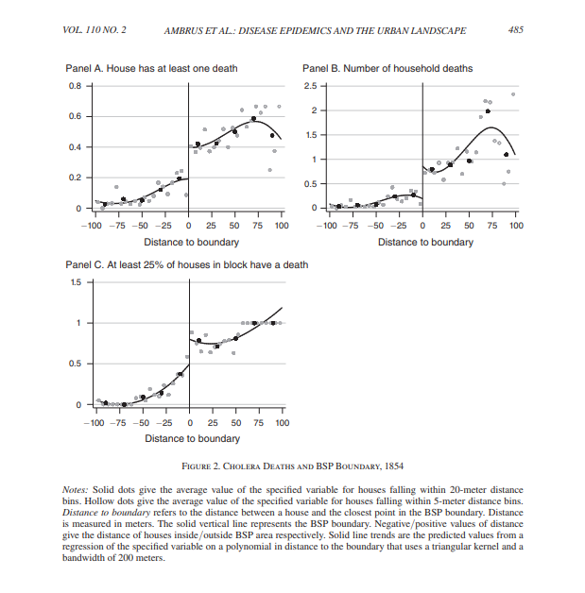
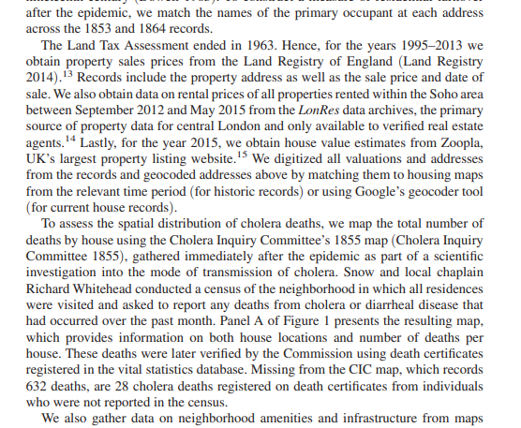
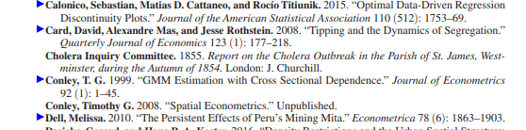
Credibility
https://doi.org/10.1257/aer.20190759

Slide 57
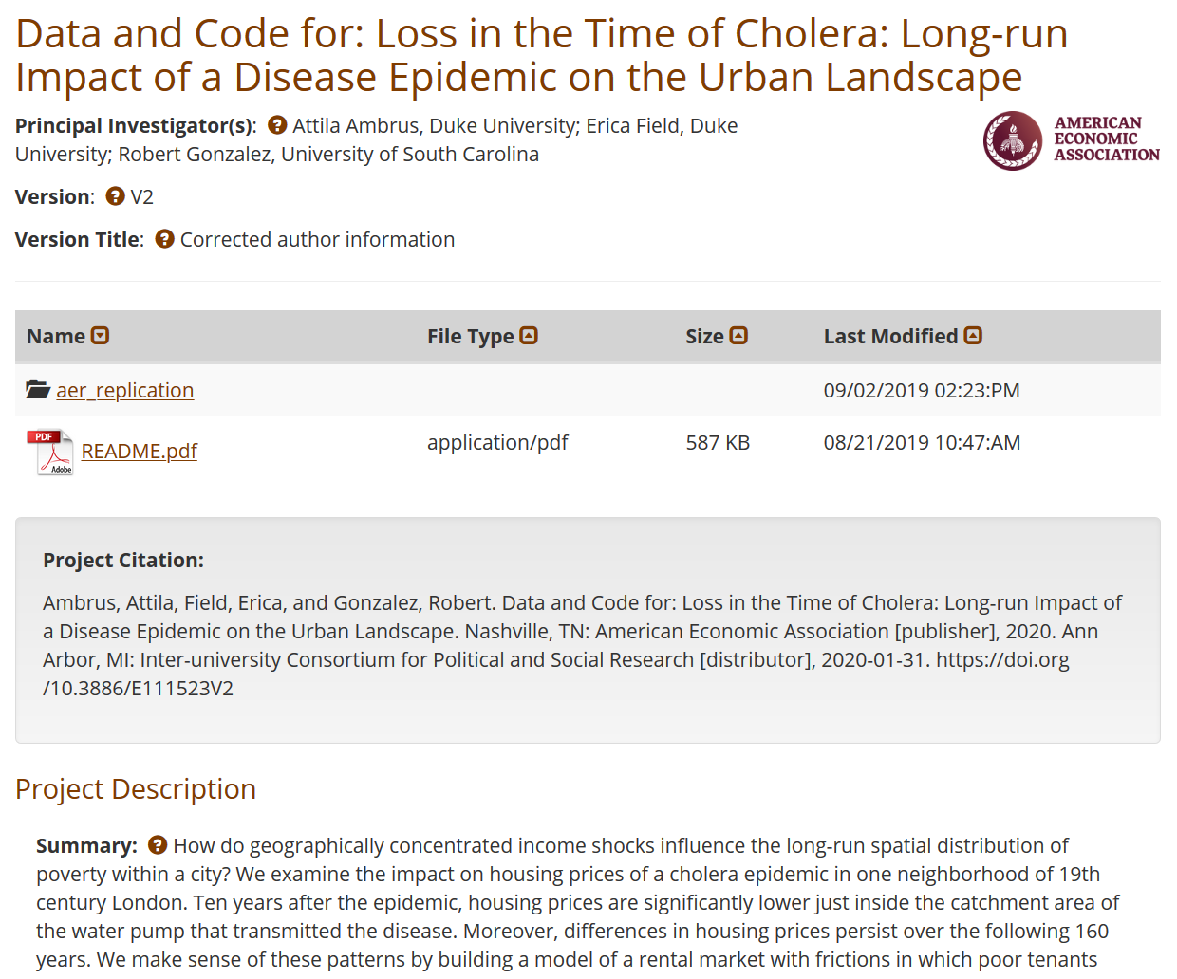
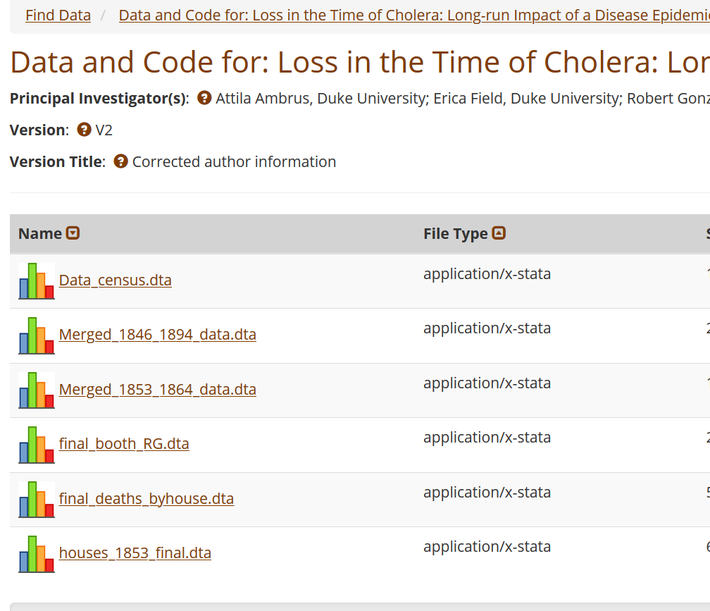
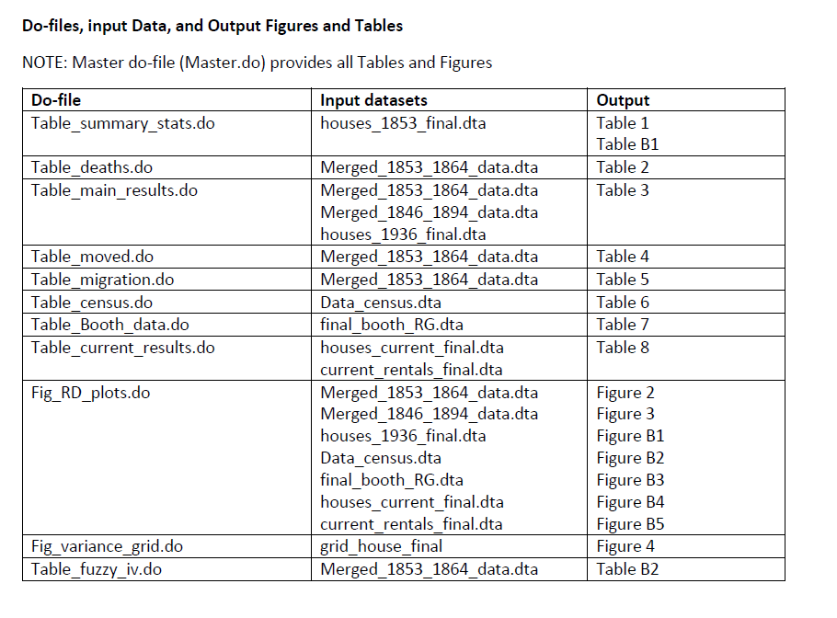

Slide 58
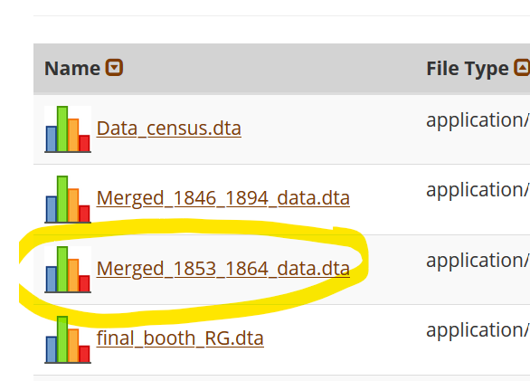
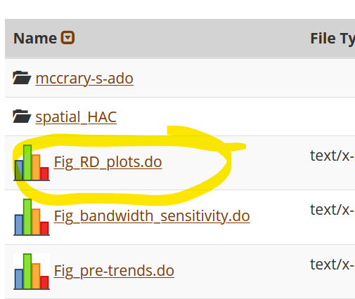

Slide 59
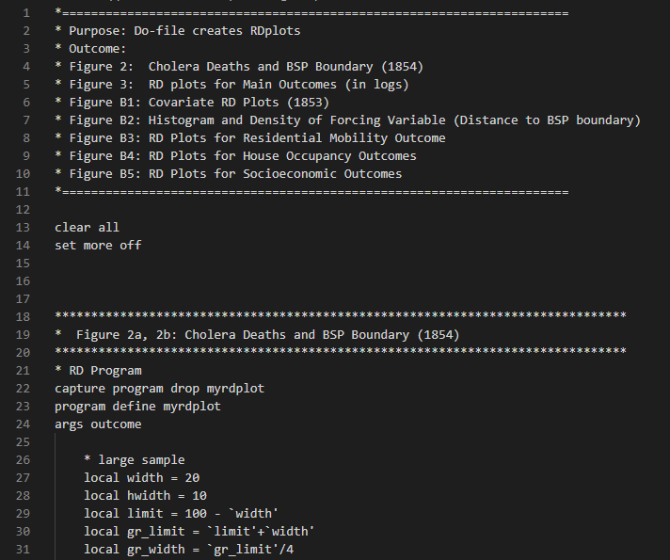

Slide 60
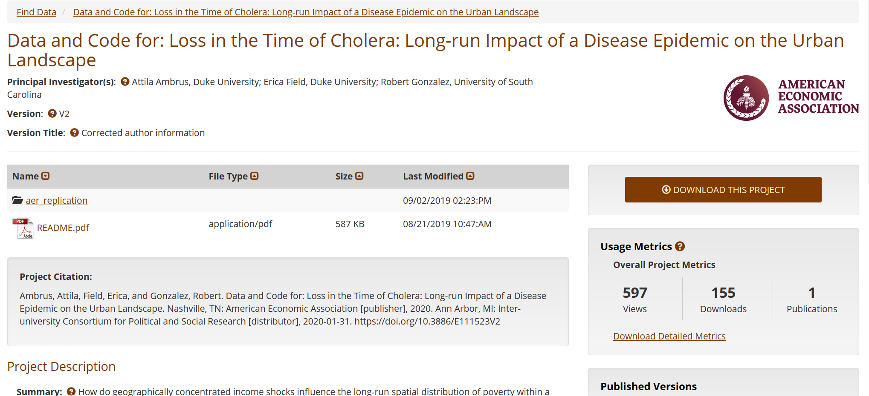
Reproducibility

Slide 61
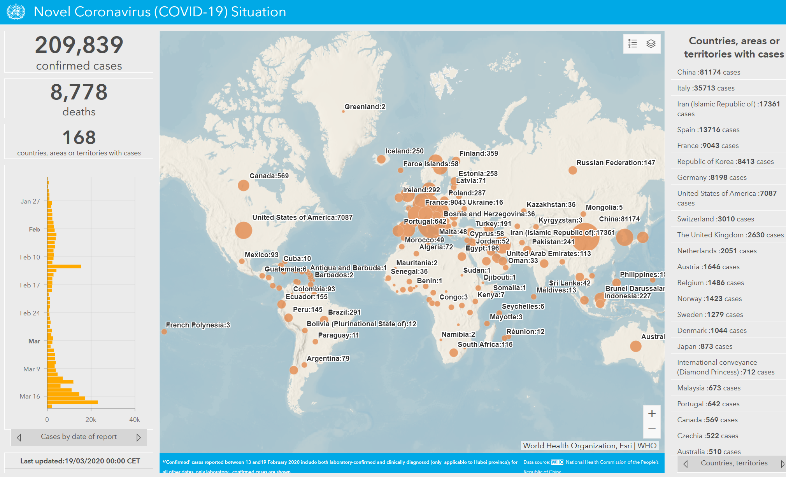
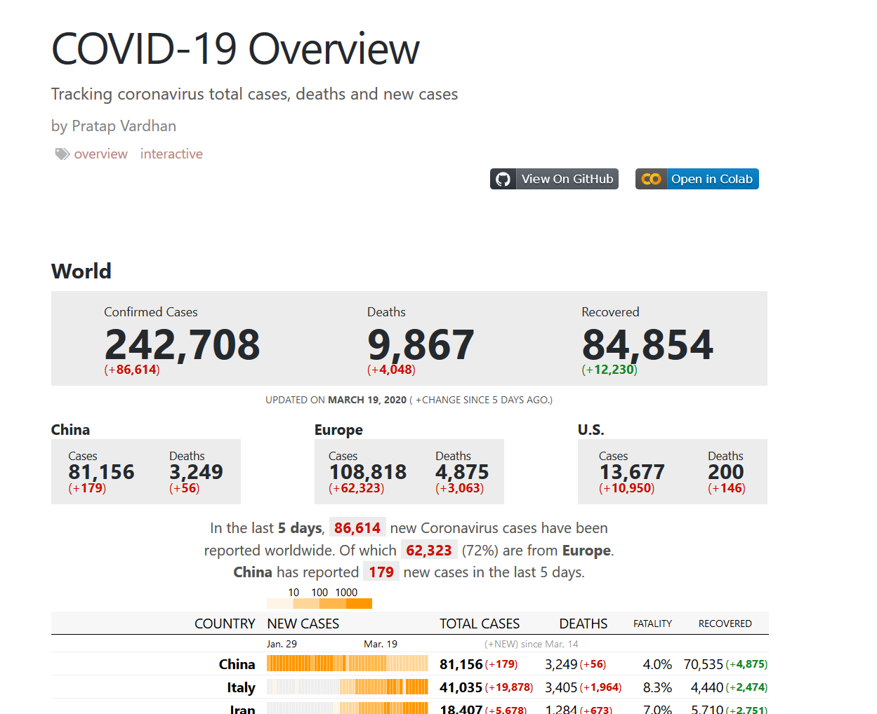
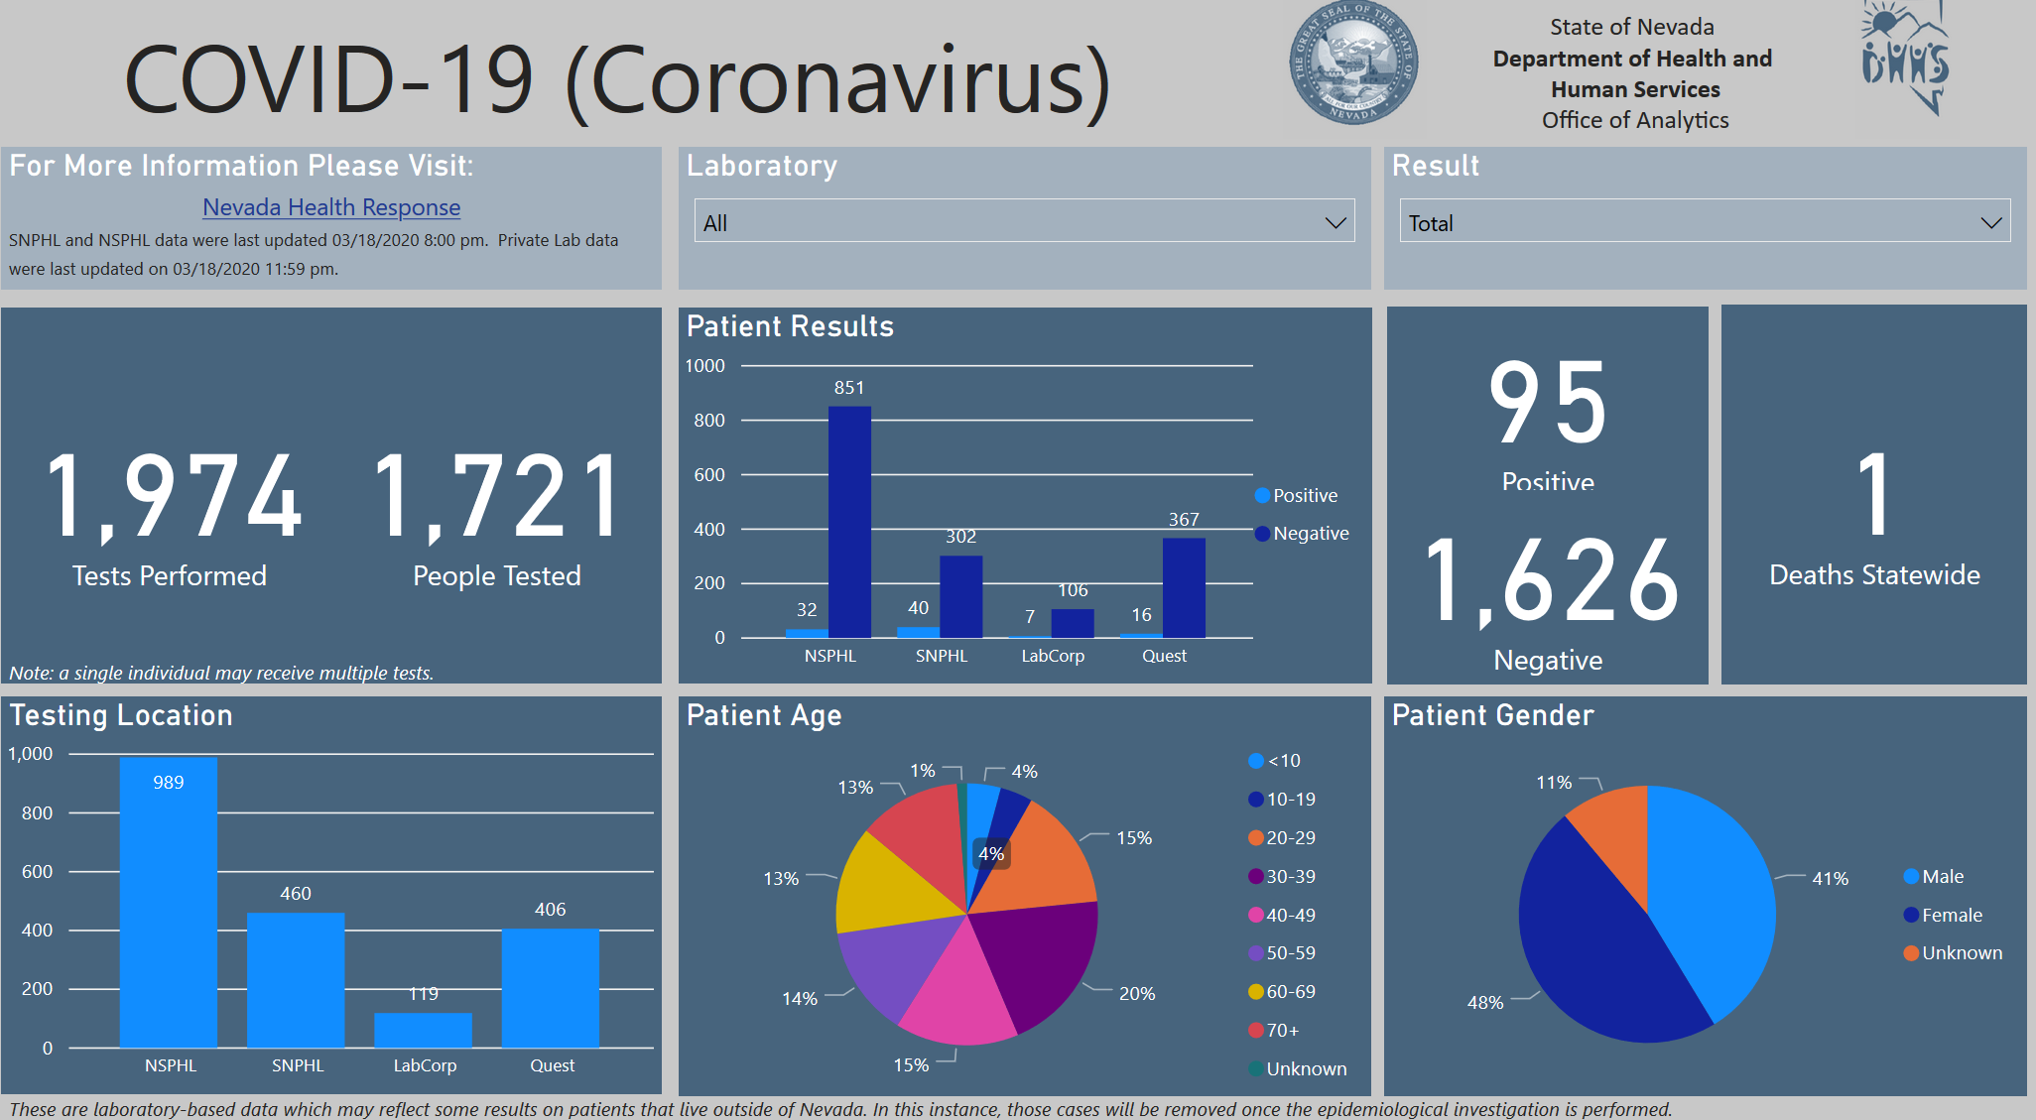
Credibility

Slide 62
Notes:
OK. So what am I doing in all of this?

Slide 63

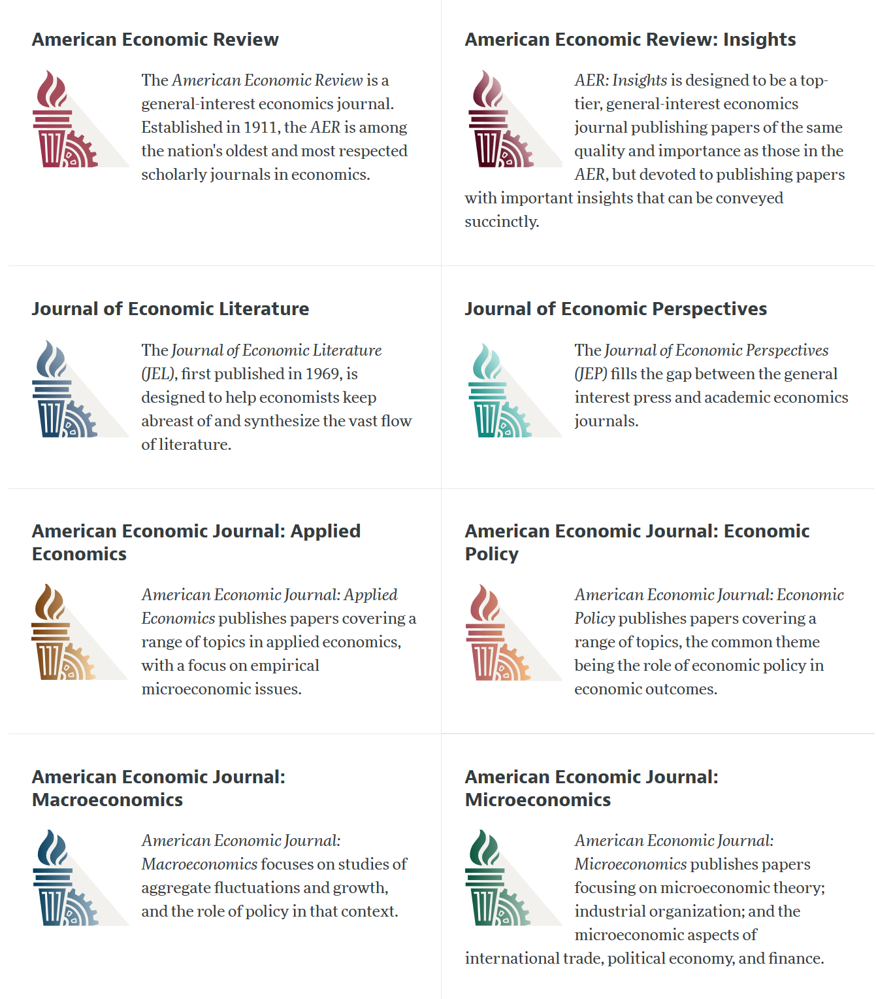

Slide 64
Current efforts at the AEA
Pre-emptively improve code archives
By conducting reproducibility checks when we can
By working with groups that conduct reproducibility checks when we cannot
Better archives
Greater transparency of the code and data archives
Better provenance tracking
Leave code where it is when appropriate
Leave data where it is almost always
Display that information
Notes:
Add logo from AEA

Slide 65
AEA “Data Availability Policy” (2018)
It is the policy of the American Economic Association to publish papers only if the data used in the analysis are clearly and precisely documented and are readily available to any researcher for purposes of replication.
Authors of accepted papers that contain empirical work, simulations, or experimental work must provide, prior to publication, the data, programs, and other details of the computations sufficient to permit replication. These will be posted on the AEA website. The Editor should be notified at the time of submission if the data used in a paper are proprietary or if, for some other reason, the requirements above cannot be met.

Slide 66
AEA Data Availability Policy (2018)
It is the policy of the American Economic Association to publish papers only if the data used in the analysis are clearly and precisely documented and are readily available to any researcher for purposes of replication.
Authors of accepted papers that contain empirical work, simulations, or experimental work must provide, prior to publication, the data, programs, and other details of the computations sufficient to permit replication. These will be posted on the AEA website. The Editor should be notified at the time of submission if the data used in a paper are proprietary or if, for some other reason, the requirements above cannot be met.
documented
clearly and precisely
readily available
must provide, prior to publication
details
sufficient to
permit replication
posted on the AEA website

Slide 67
AEA Data Availability Policy (2018)
clearly and precisely documented
readily available
must provide, prior to publication
details sufficient to permit replication
posted on the AEA website.

Slide 68
July 16, 2019

Slide 69
AEA Data & Code Availability Policy (2019)
It is the policy of the American Economic Association to publish papers only if the data used in the analysis are clearly and precisely documented and access to the data and code is clearly and precisely documented and is non-exclusive to the authors.
Authors of accepted papers that contain empirical work, simulations, or experimental work must provide, prior to acceptance, the data, programs, and other details of the computations sufficient to permit replication, as well as information about access to data and programs.

Slide 70
AEA DCAP (2018→2019)
These will be posted on the AEA website. The Editor should be notified at the time of submission if the data used in a paper are proprietary or if, for some other reason, the requirements above cannot be met.
Data and programs should be archived in the AEA Data and Code Repository. Authors will provide access to editors and reviewers, if requested, to both data and programs prior to acceptance. The Editor should be notified at the time of submission if access to the data used in a paper is restricted or limited, or if, for some other reason, the requirements above cannot be met. The AEA Data Editor will assess compliance with this policy, and will verify the accuracy of the information prior to acceptance by the Editor.

Slide 71
Current efforts at the AEA
Pre-emptively improve code archives
By conducting reproducibility checks when we can
By working with groups that conduct reproducibility checks when we cannot
Better archives
Greater transparency of the code and data archives
Better provenance tracking
Leave code where it is when appropriate
Leave data where it is almost always
Display that information
Notes:
Add logo from AEA

Slide 72
AEA Pre-Publication Verification
Every paper that receives a “conditional acceptance” is verified
Data citations
Quality of README
Quality of code
Reproducibility of code
Quality of metadata in the repository

Slide 73
Replication continuum
Same data | Same code | Same methods | Same context
08
Reproducibility
Narrow Replication (Pesaran 2003)
Pure Replication (Hamermesh 2007)
Verification (Clemens 2015)

Slide 74
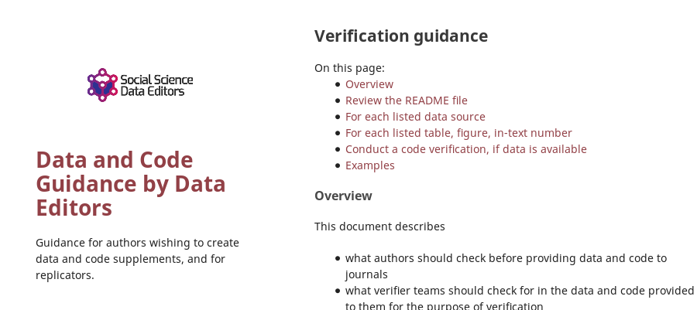

Action: Reproducibility Check

Slide 75
Who is doing that?
Earlier reproducibility work: Flavio Stanchi (now at AirBnb), Sylverie Herbert (on the market), Hautahi Kingi (Impaq)
Current lead graduate students: David Wasser (until Dec 2019), Meredith Welch (since Jan 2020)
Current and past undergraduate students: Alexia Ge, Anthony Peraza, Craig Schulman, Elijah B. Ruiz, Gabriel Bond, Jason S. Katz, Jeong Hyun Lee, Jiayin Song, John Park, Joshua Passel, Kirubeal T. Wondimu, Linchen Zhang, Louis Liu, Luis Lopez Cabrera, Luke O’Leary, Mary-Jo Ajiduah, Naomi Li, Nicholas Swan, Nishat Peuly, Ryan Ali, Samuel Frey, Siyang (Elaine) Yu, Steve Yeh, Weilun Shi, William Hernandez, Yanyun (Iris) Chen, Yuan-Hsuan (Sharon) Lin, Zebang Xu, Xing Su, Jiazhen Tan , Xueshi Su, Vendela Norman, Anderson Park, Nehedin Juarez, Rubal Mistry, Syon Verma, William Silverman, Zechariah Karsana
Other graduate students: Aviv Caspi, Leah Kim

Slide 76
Goal: Improve reproducibility

Slide 77
Verifying Data and Code Deposits
Check README
Legible? Intelligible? Complete?
Check Code
Where is Table 1? Figure 1? Could this work?
Check Access Rights
Can the author provides us with data?
Does the data access as described work?

Slide 78
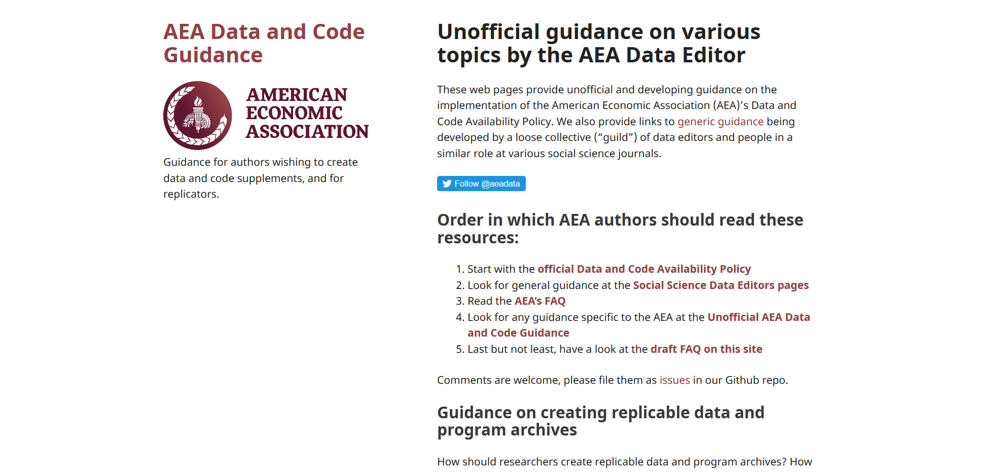

Slide 79
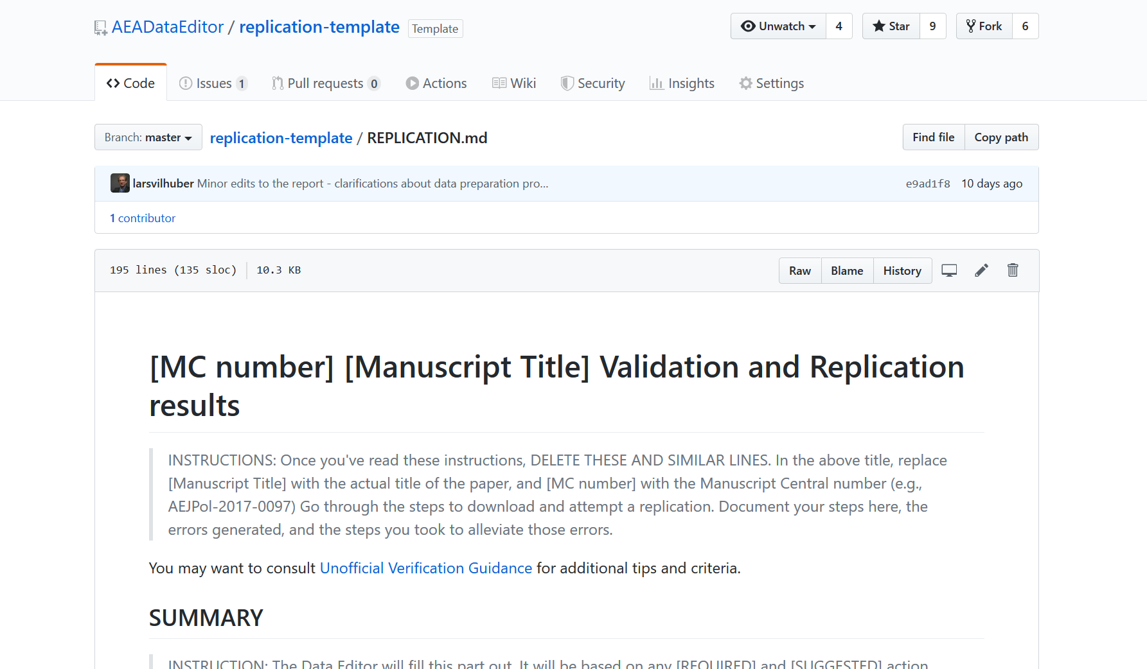

Slide 80
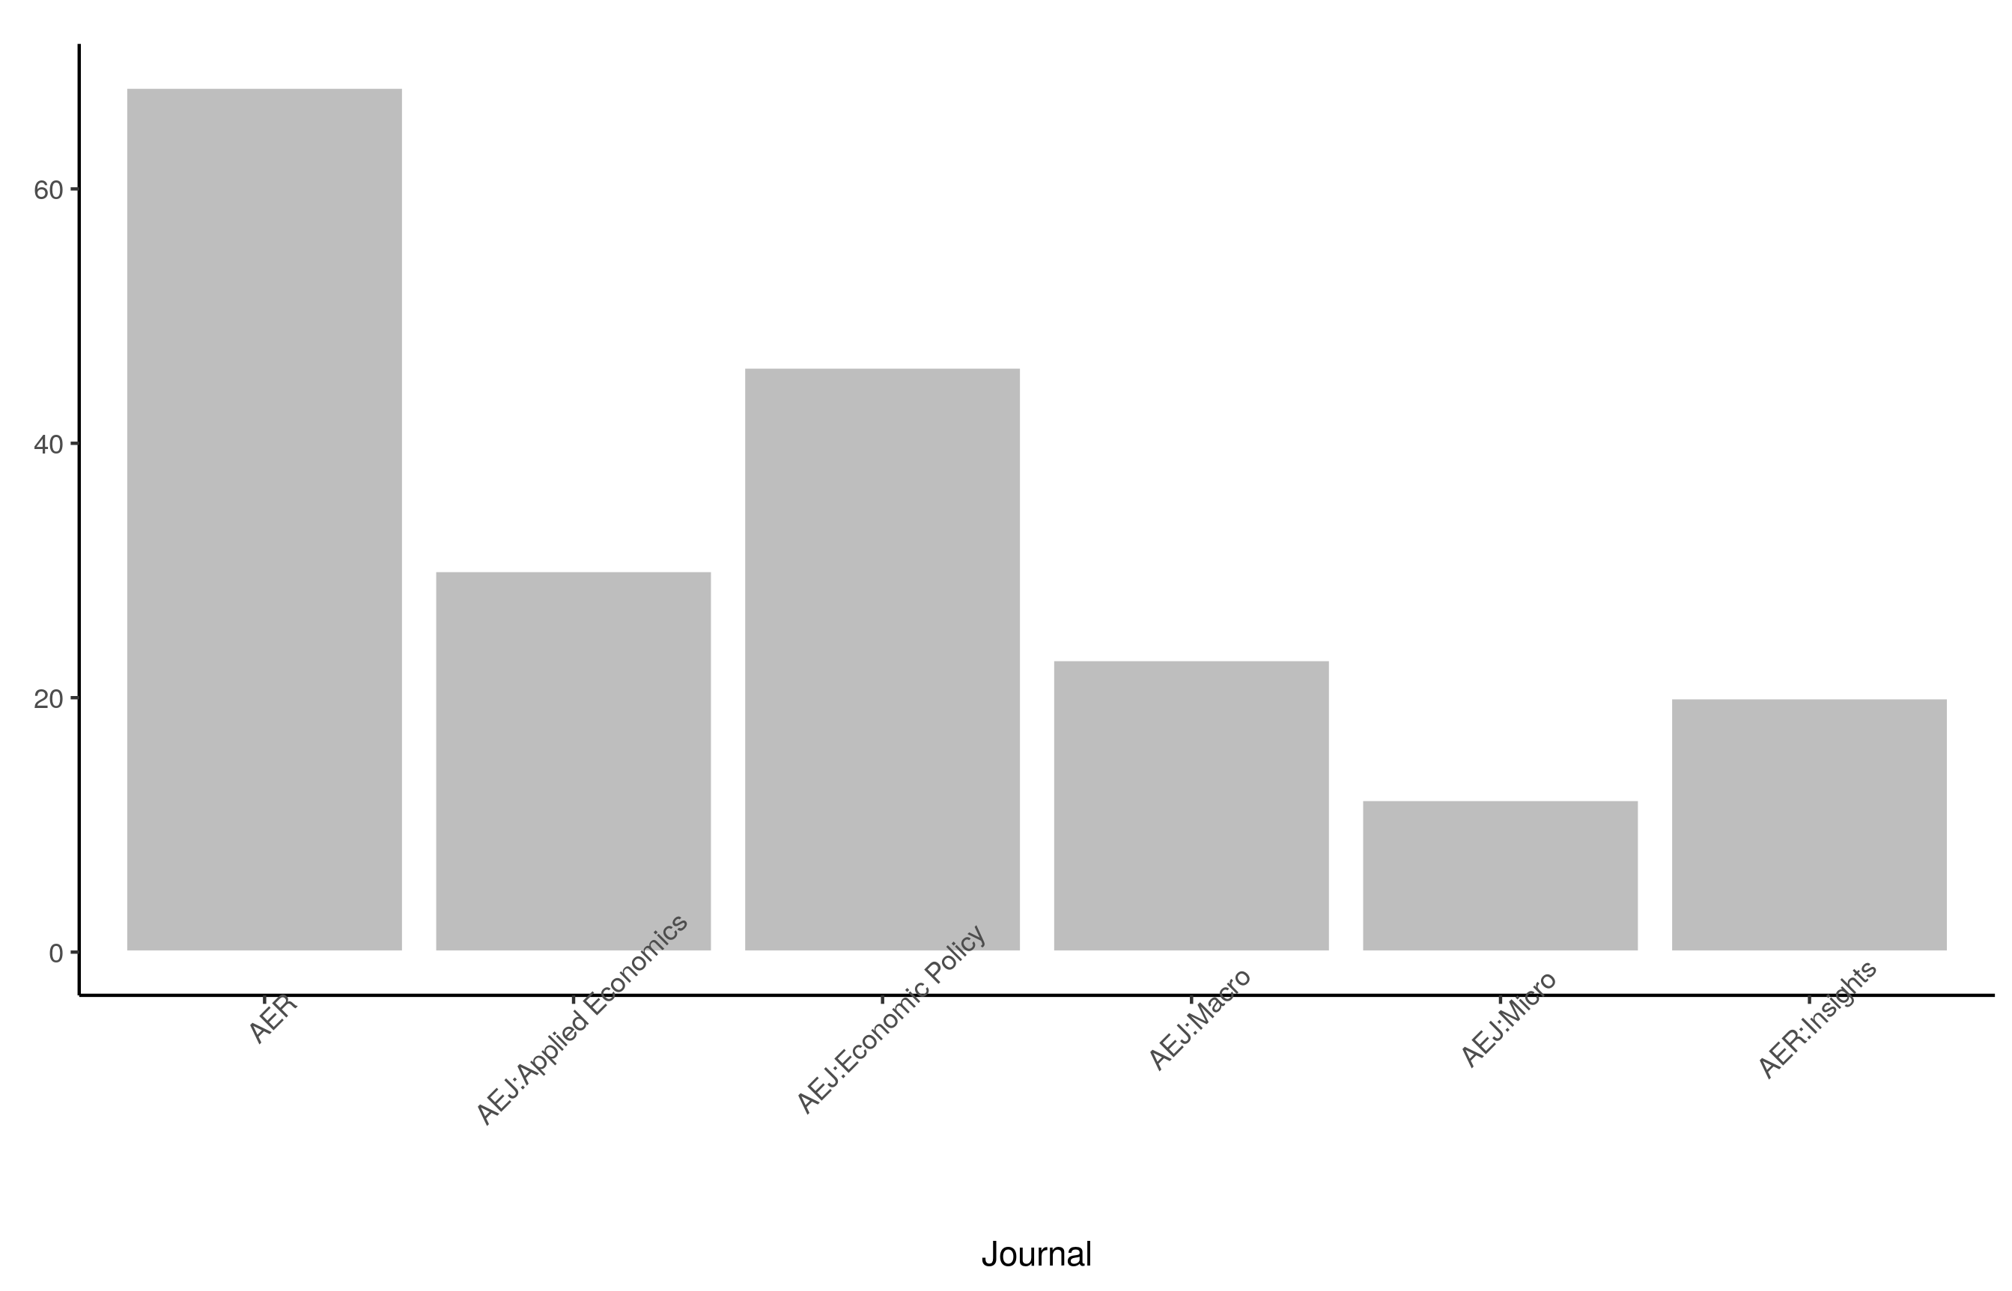
Stats on reproduced articles
Between July 16, 2019, and November 28, 2019 (4.5 mths), the AEA Data Editor team conducted
216 assessments
for 138 manuscripts.
(as of today, approx. 600 assessments)

Slide 81
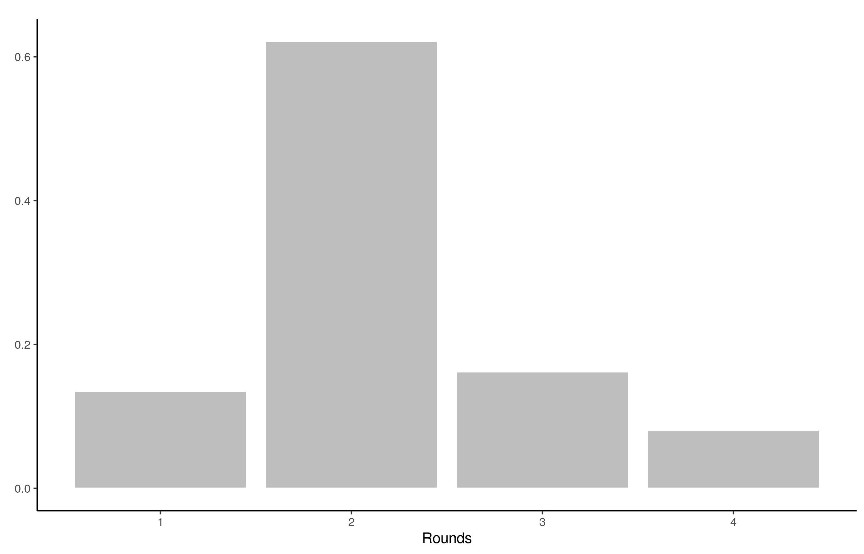
Stats on reproduced articles
The typical article goes through at least two rounds of assessment (none were perfect)
Conversely, not a single study was irreproducible (not supporting manuscript claims)

Slide 82
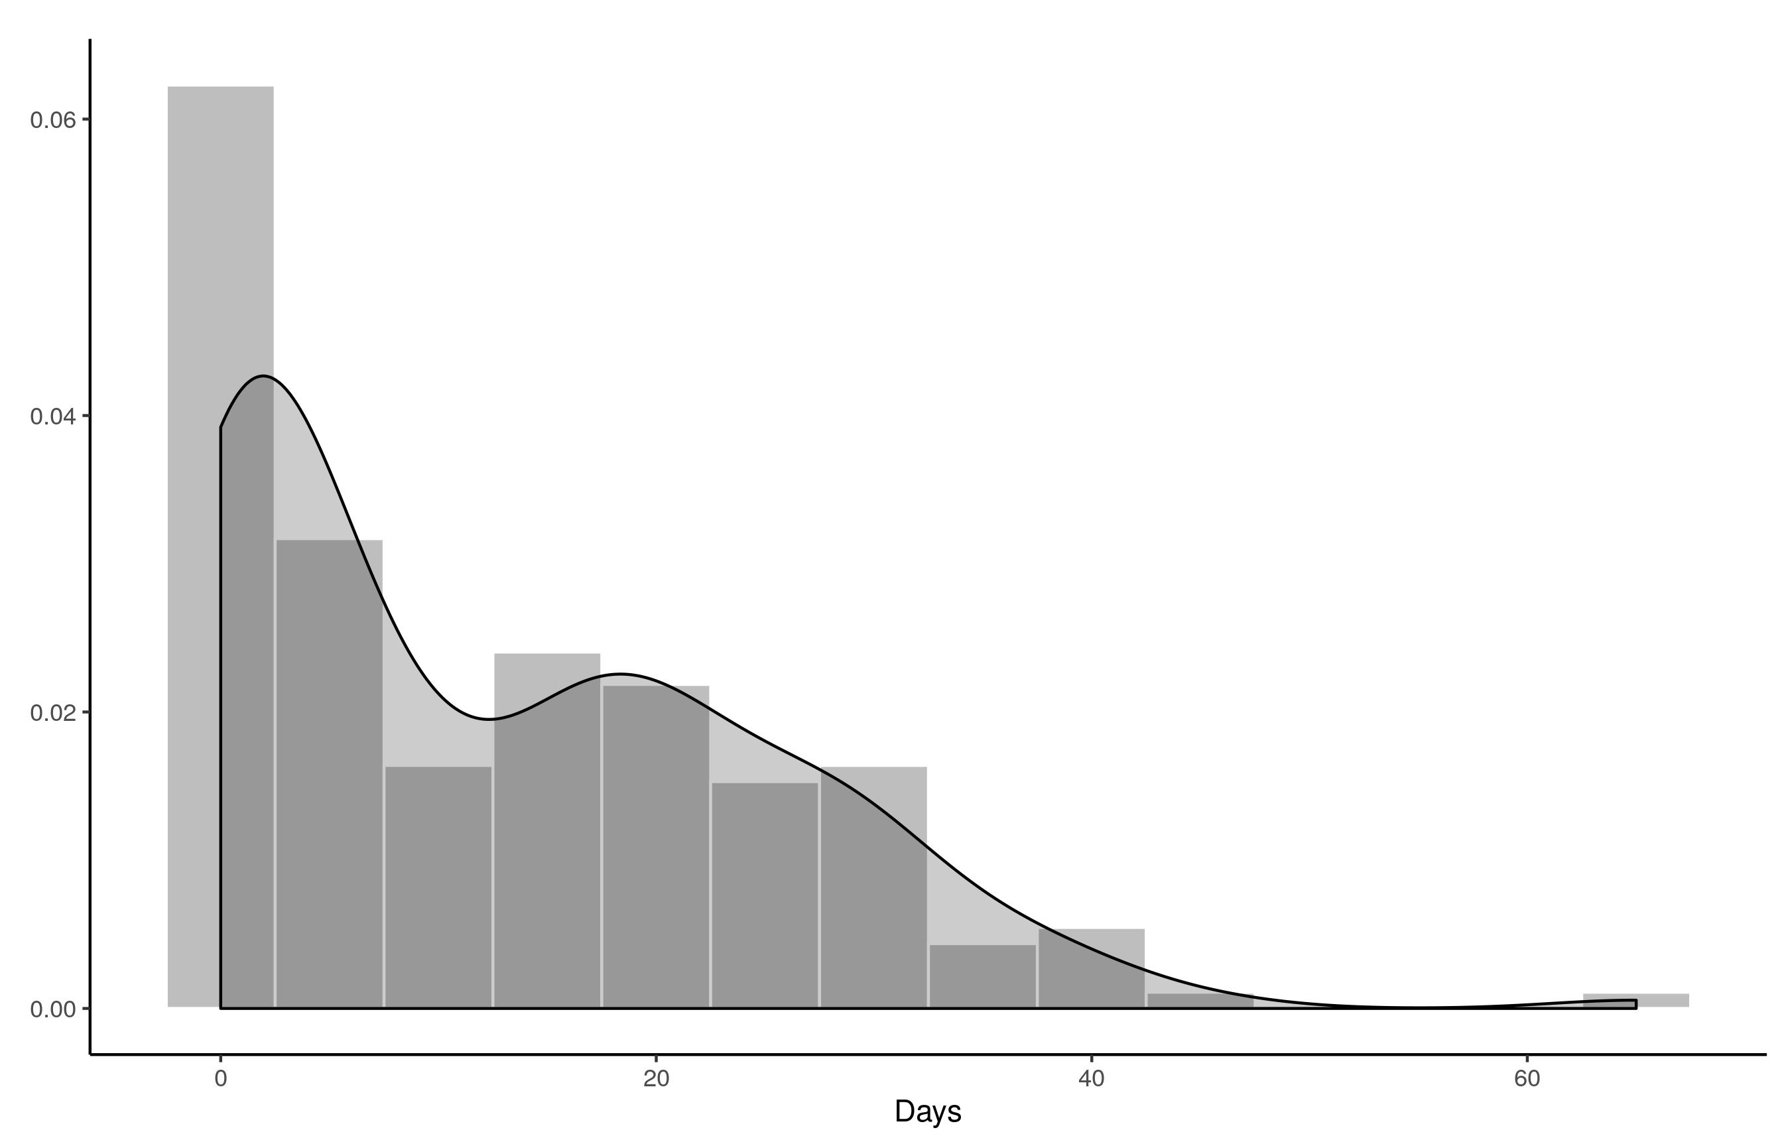
Stats on reproduced articles
Goal is turnaround of two weeks
Currently still too long

Slide 83
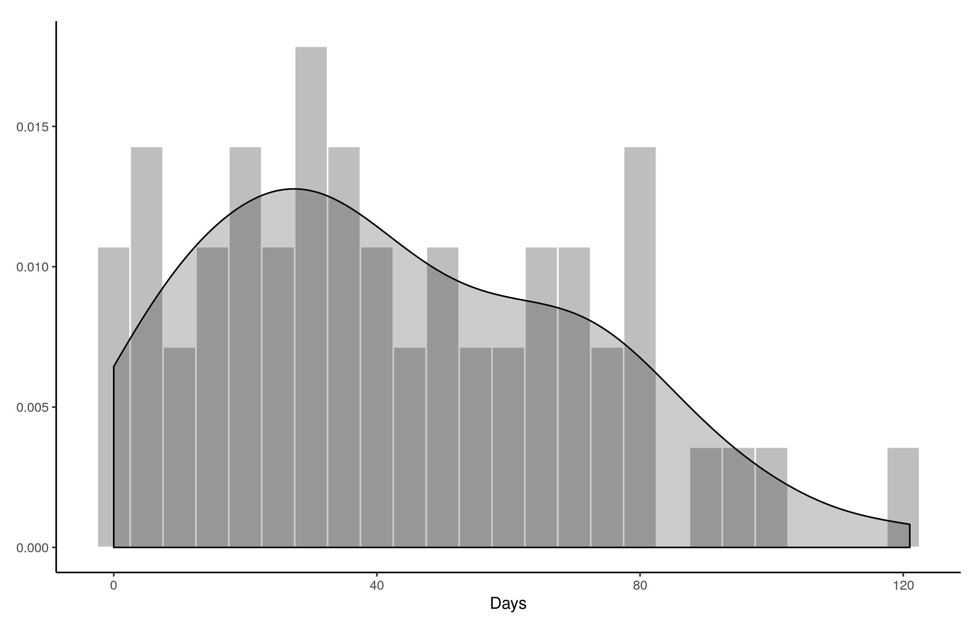
Stats on reproduced articles
Total time (from first submission to final signoff) is too long

Slide 84
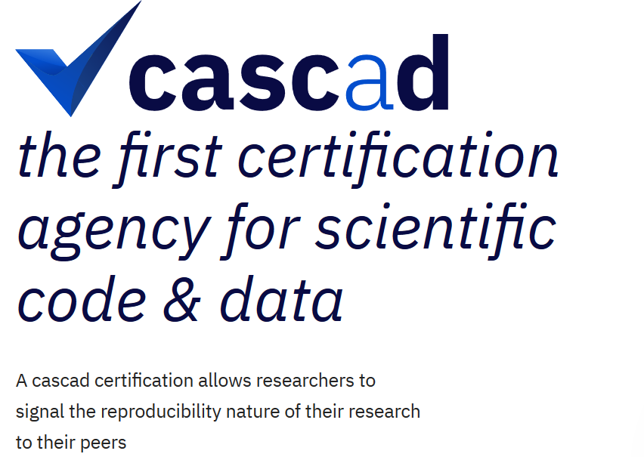



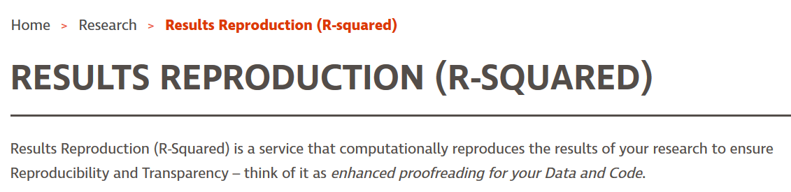
Increasing team size
Grown from 7 undergrads + 1 graduate assistant
To 18 undergraduates, 15 trainees, + 1 graduate assistant (+ 1 volunteer)
And:

Slide 85
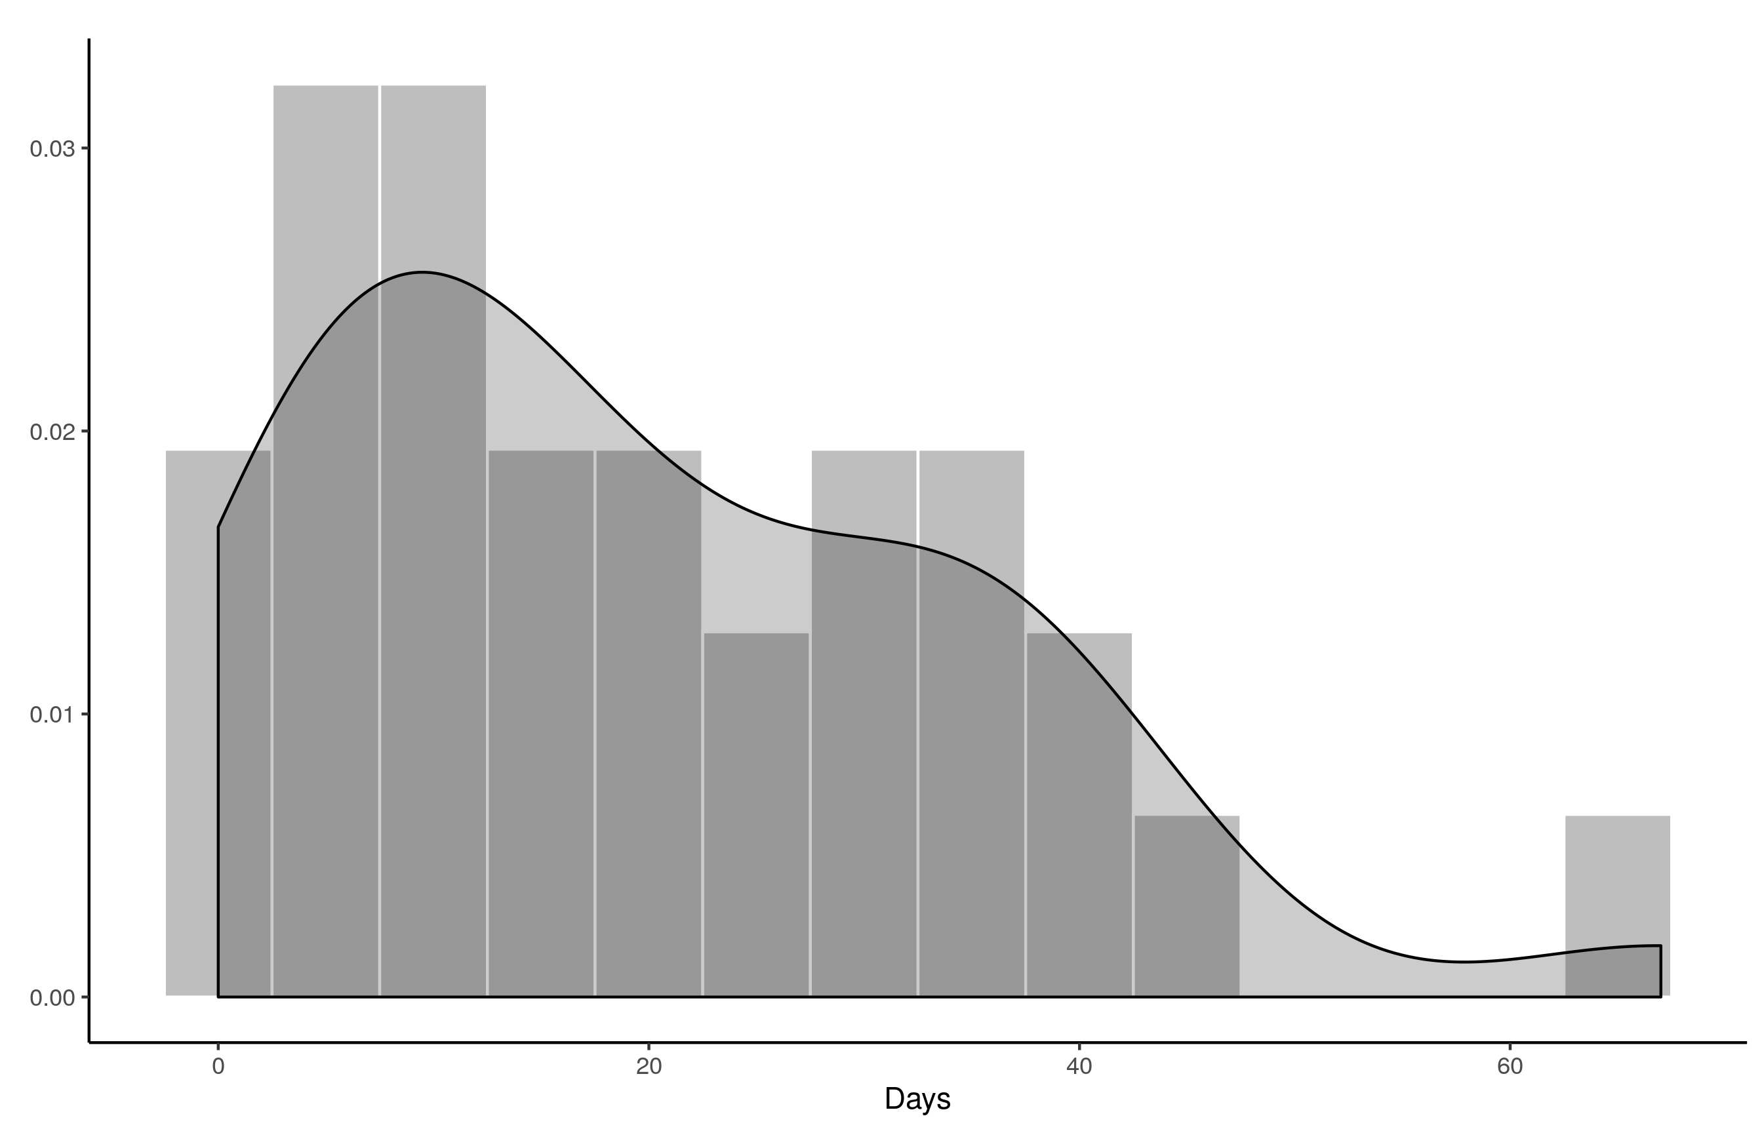
Stats on reproduced articles
But author response time is also a contributor
0 20 40 60

Slide 86
Current efforts at the AEA
Pre-emptively improve code archives
By conducting reproducibility checks when we can
By working with groups that conduct reproducibility checks when we cannot
Better archives
Greater transparency of the code and data archives
Better provenance tracking
Leave code where it is when appropriate
Leave data where it is almost always
Display that information
Notes:
Add logo from AEA

Slide 87
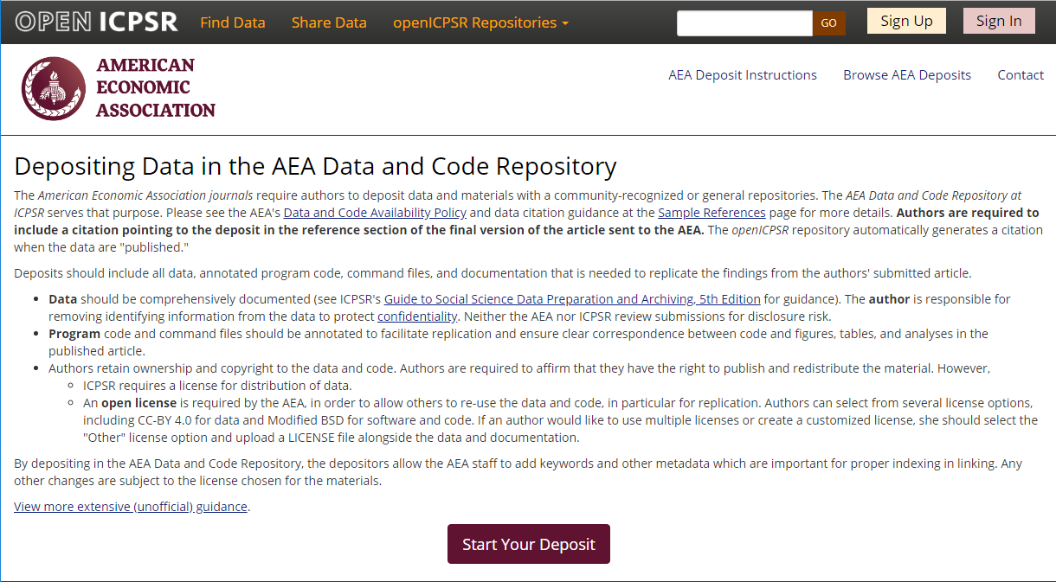
Full-featured repository

Slide 88
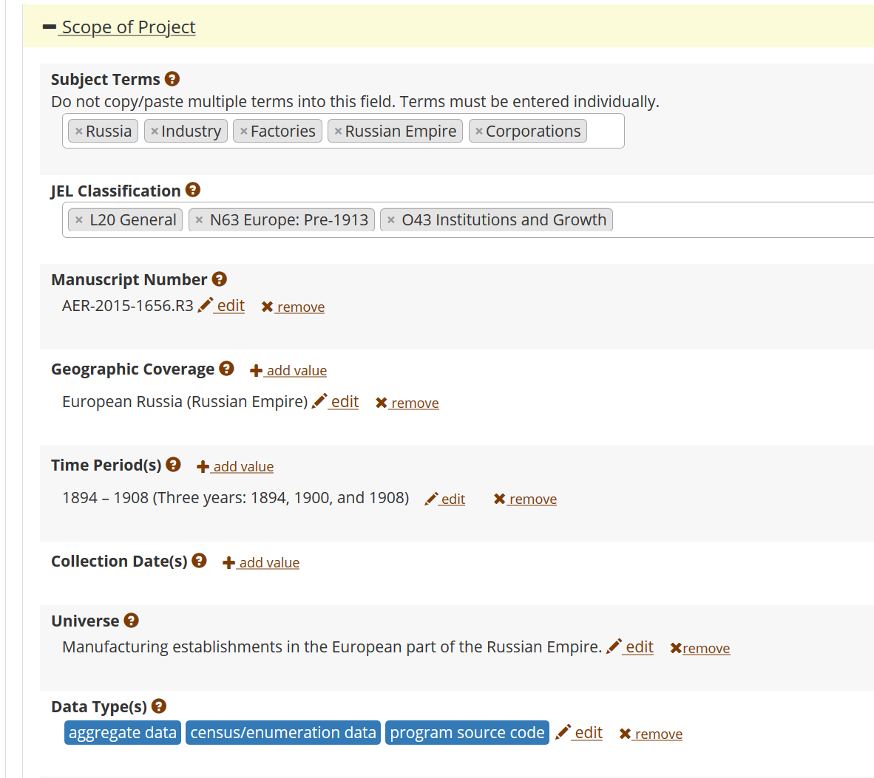
FAIR data principles rely on metadata
Notes:
Show metadata for this page

Slide 89
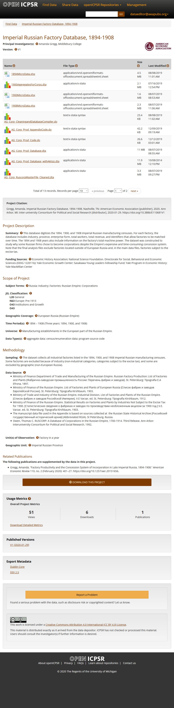
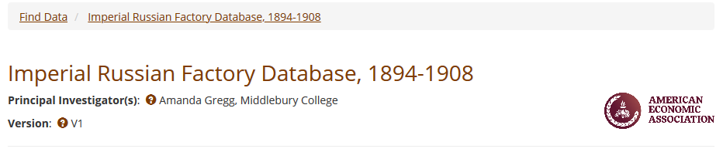
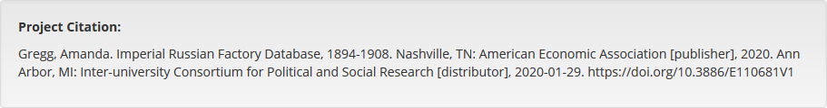
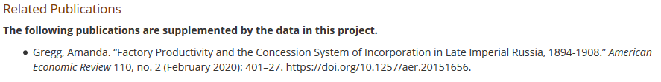

Slide 90
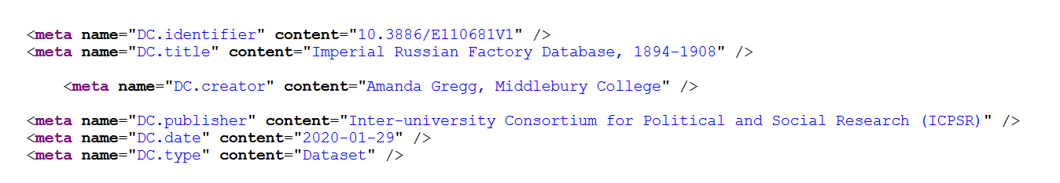

Slide 91
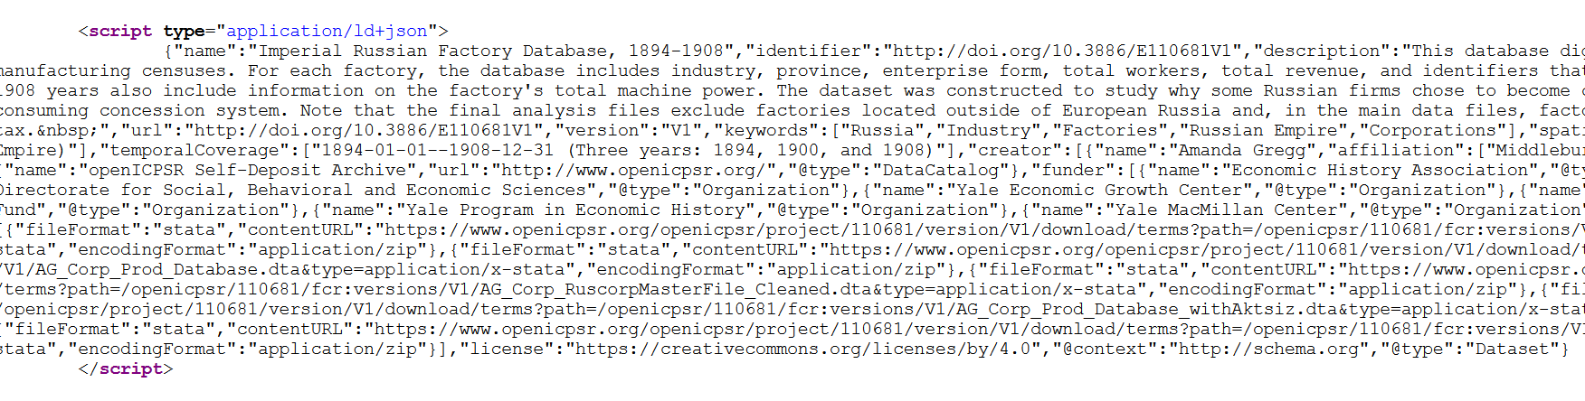

Slide 92
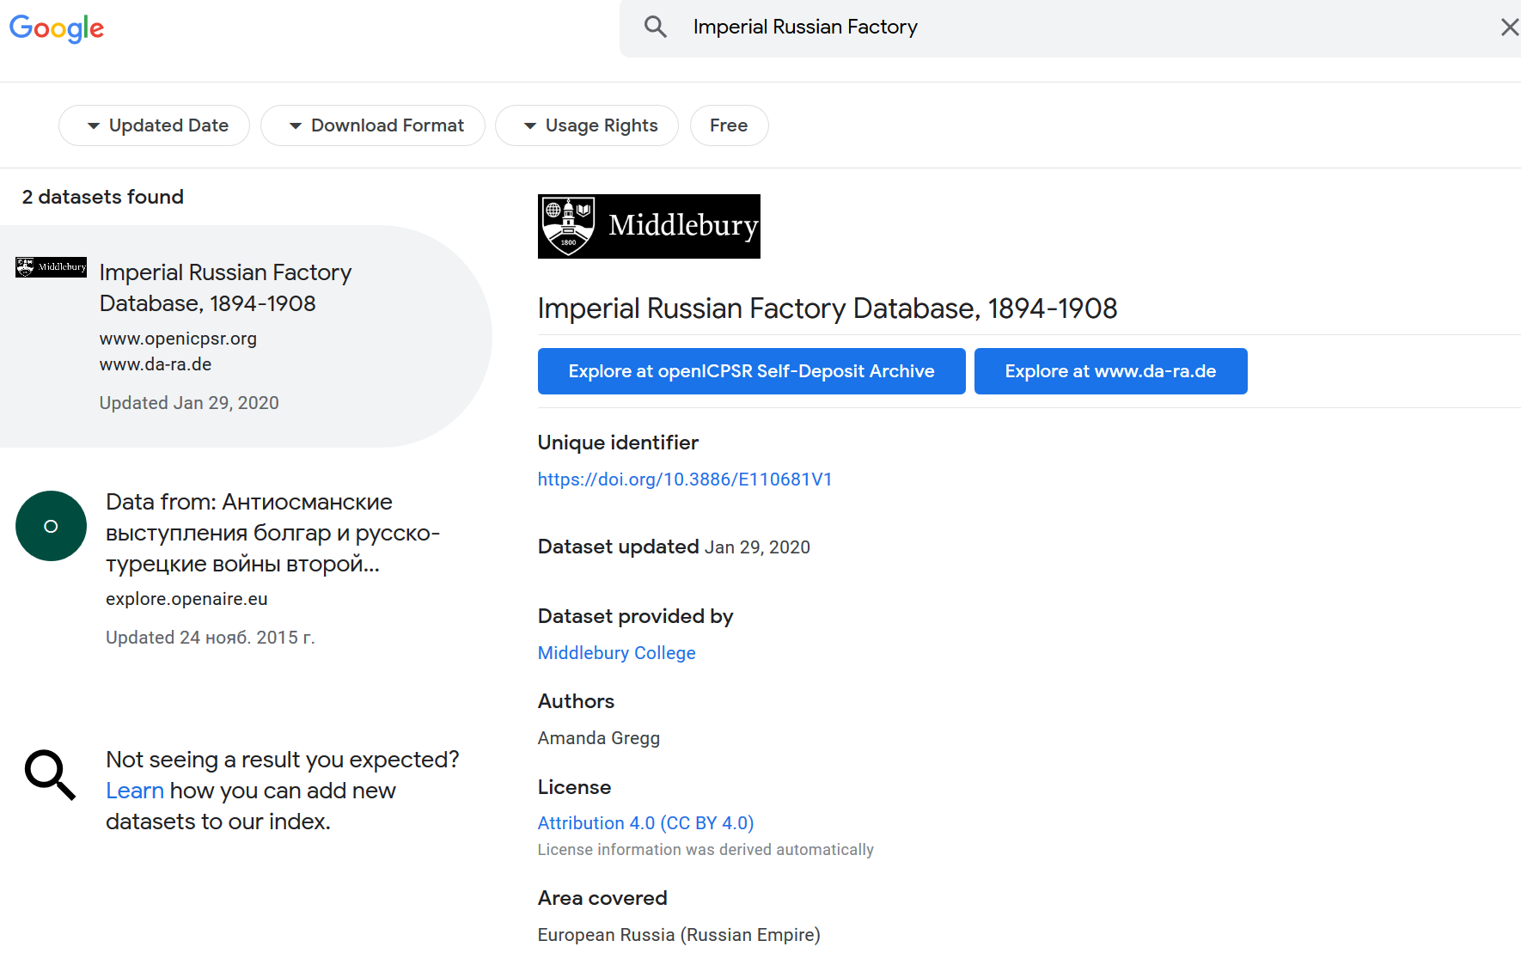
… and findability relies on metadata

Slide 93
Oct 11, 2019

Slide 94
Migrating archives
Between Oct 11 and Oct 13, 2019, the staff at openICPSR ingested 2,552 historical AEA supplements, increasing the size of the openICPSR repository by a factor of 3.
The migrated archives are now available through the openICPSR search interface, the general ICPSR search interface, as well as through a variety of federated search interfaces such as Google Dataset Search.

Slide 95
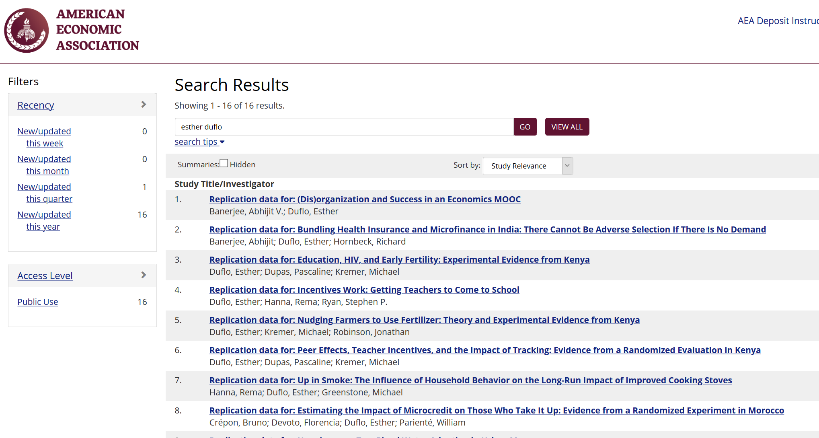

Slide 96


Slide 97


Slide 98

Some statistics
Stata is the most popular statistical software in the journals of the AEA (72.96% of all supplements)
followed by Matlab (22.45%)

Slide 99


More stats

Slide 100
Current efforts at the AEA
Pre-emptively improve code archives
By conducting reproducibility checks when we can
By working with groups that conduct reproducibility checks when we cannot
Better archives
Greater transparency of the code and data archives
Better provenance tracking
Leave code where it is when appropriate
Leave data where it is almost always
Display that information
Notes:
Add logo from AEA

Slide 101

Starts with Data Citations
Data Citation Principles
Image of a standard data citation
Data Citation Synthesis Group: Joint Declaration of Data Citation Principles. Martone M. (ed.) San Diego CA: FORCE11; 2014 [https://www.force11.org/group/joint-declaration-data-citation-principles-final].

Slide 102
AEA “Data Availability Policy” (2019)
It is the policy of the American Economic Association to publish papers only if the data used in the analysis are clearly and precisely documented and access to the data and code is clearly and precisely documented and is non-exclusive to the authors.
Authors of accepted papers that contain empirical work, simulations, or experimental work must provide, prior to acceptance, the data, programs, and other details of the computations sufficient to permit replication, as well as information about access to data and programs.

Slide 103
Every manuscript is checked
What datasets are used
Are they cited?
→ in Article?
→ in Online Appendix?
→ in README?

Slide 104

Every manuscript is checked
What datasets are used
Are they cited?
Is there additional information on access?
→ URL leads to exact data?
→ URL leads to application procedure?
→ other access procedure is described?
Le labyrinthe des juges, par Guillaume Beck

Slide 105
Every manuscript is checked
What datasets are used
Are they cited?
Is there additional information on access?
Is there license/ data use information?
→ Should the author provide the data?
→ Is the author allowed to provide data?

Slide 106
Evolving Journal and Data Infrastructure
Authors struggle with this!

Slide 107

Notes:
A real example!

Slide 108
Evolving Journal and Data Infrastructure
Data Publishers struggle with this!

Slide 109

Example 1: OECD
URL does not always change!
(but sometimes it does)

Slide 110

Example 1: OECD
URL does not always change!
(but sometimes it does)

Slide 111

Example 1: OECD
URL does not always change!
(and then it doesn’t…)

Slide 112

Example 2: Academic data publisher

Slide 113

Example 2: Academic data publisher

Slide 114

Example 2: Academic data publisher-new!

Slide 115

Notes:
Not the same provider!

Slide 116


Example 3: FRED (St. Louis Fed)

Slide 117


Example 4: German Restricted-access

Slide 118
Example 4: German Restricted-access

Slide 119


Example 4: German Restricted-access

Slide 120
Some Suggestions

Slide 121
For authors

Slide 122
Action: Encourage Best Practices
Follow robust coding
Ensure that code reliably produces results (possibly automated)
Before you finish the manuscript, run all analysis code again (if not too onerous)

Slide 123

Streamlining replication packages
Master script preferred
Least amount of manual effort
No manual manipulation
“Change the parameter to 0.2, then run the code again”
No manual copying of results
Write out/save tables and figures using packages
Compute all numbers in package
No manual install of packages
Use a script to create all directories, install all necessary packages/requirements/etc.
Clear instructions!

Slide 124


Provide data citations (in manuscript) and data availability statements (in README or appendix)

Slide 125
Proposed: Explicit DAS or
Incorporate into standardized README

Slide 126
For institutions

Slide 127
Better support for researchers
Training in methods (with various centers, institutions, etc.)
For current researchers (Carpentries, custom, etc.)
For integration into curriculums
Tools to streamline the process
DOI for research data
Facilitate citation according to various practices (media, academia)
Awareness
Consider as part of performance measurement
Assess as part of institutional reputation

Slide 128





Emphasize training in methods
Training for replicators
https://labordynamicsinstitute.github.io/replicability-training/
https://github.com/BITSS/ACRE/
https://www.projecttier.org/

Slide 129
Formal internal verification services?
What is the (reputational) cost of irreproducible outputs?
What is the (time, money) cost of verifying reproducibility?
What is the cost/benefit of transparency?

Slide 130




Slide 131


Tension between access and reproducibility

Slide 132


Verification services

Slide 133
Verification services
Your students!
Your colleagues!

Slide 134
For journals

Slide 135
Goal: Transportability
Any standards, tools, methods: must be transportable across journals (no custom solutions)

Slide 136



Social science “guild”
https:// social-science -data-editors. github.io/ guidance/

Slide 137

Richer metadata, more transparency

Slide 138
Thank you!
https://doi.org/10.5281/zenodo.3735536

Slide 139

Some resources
https://social-science-data-editors.github.io/guidance/
https://aeadataeditor.github.io/aea-de-guidance/
template README
discussion of licensing
data citation guidance
German example:
Establishment History Panel (BHP) DOI: 10.5164/IAB.BHP7516.de.en.v1
French verification service “cascade” within French RDC CASD
https://www.casd.eu/en/le-centre-dacces-securise-aux-donnees-casd/certification-de-resultats-cascad-casd/

